Slide 1
Kidney Exchange and Stable Matching
Prepared and Presented by
Zeng Yuxiang
based on the slides provided by
Prof. Tang Pingzhong

Slide 2
Case Study #1: Kidney Exchange

Slide 3
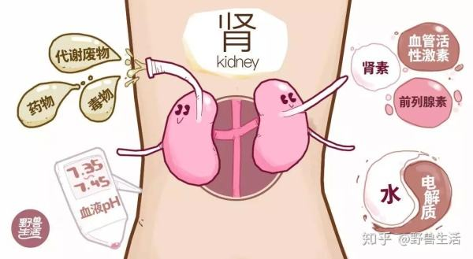
Kidney Transplants
Kidneys filter waste from blood
Kidney failure results in death in months

Slide 4
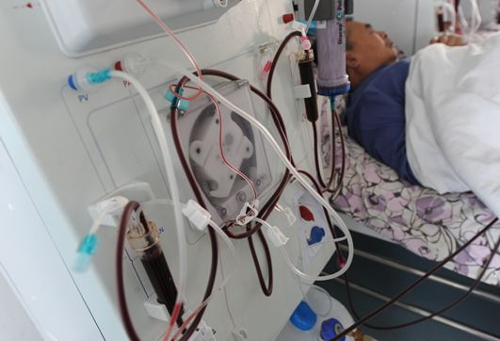

Kidney Transplants
Kidneys filter waste from blood
Kidney failure results in death in months
Dialysis(透析): regularly get blood filtered in hospital using external machine
Low quality of life

Slide 5
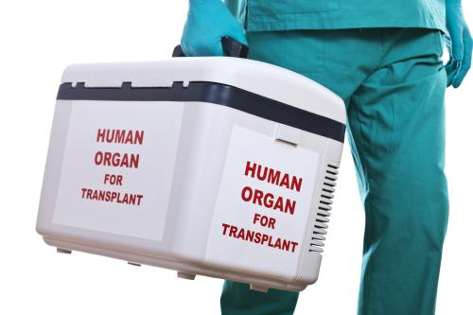
Kidney Transplants
Preferred option: kidney transplant
Cadaver kidneys (尸体肾脏)
Donation from live patient (better)
Must be compatible
Shortage of kidneys

Slide 6
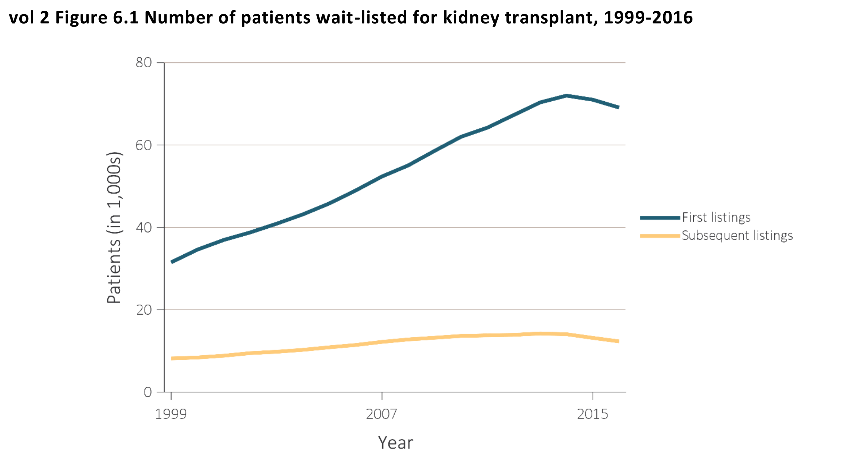
Kidney Demand
There are currently
113,000+ people
waiting for a kindey transplant in the USA.
[1] United States Renal Data System. URL: https://www.usrds.org/adr.aspx. 2019.

Slide 7
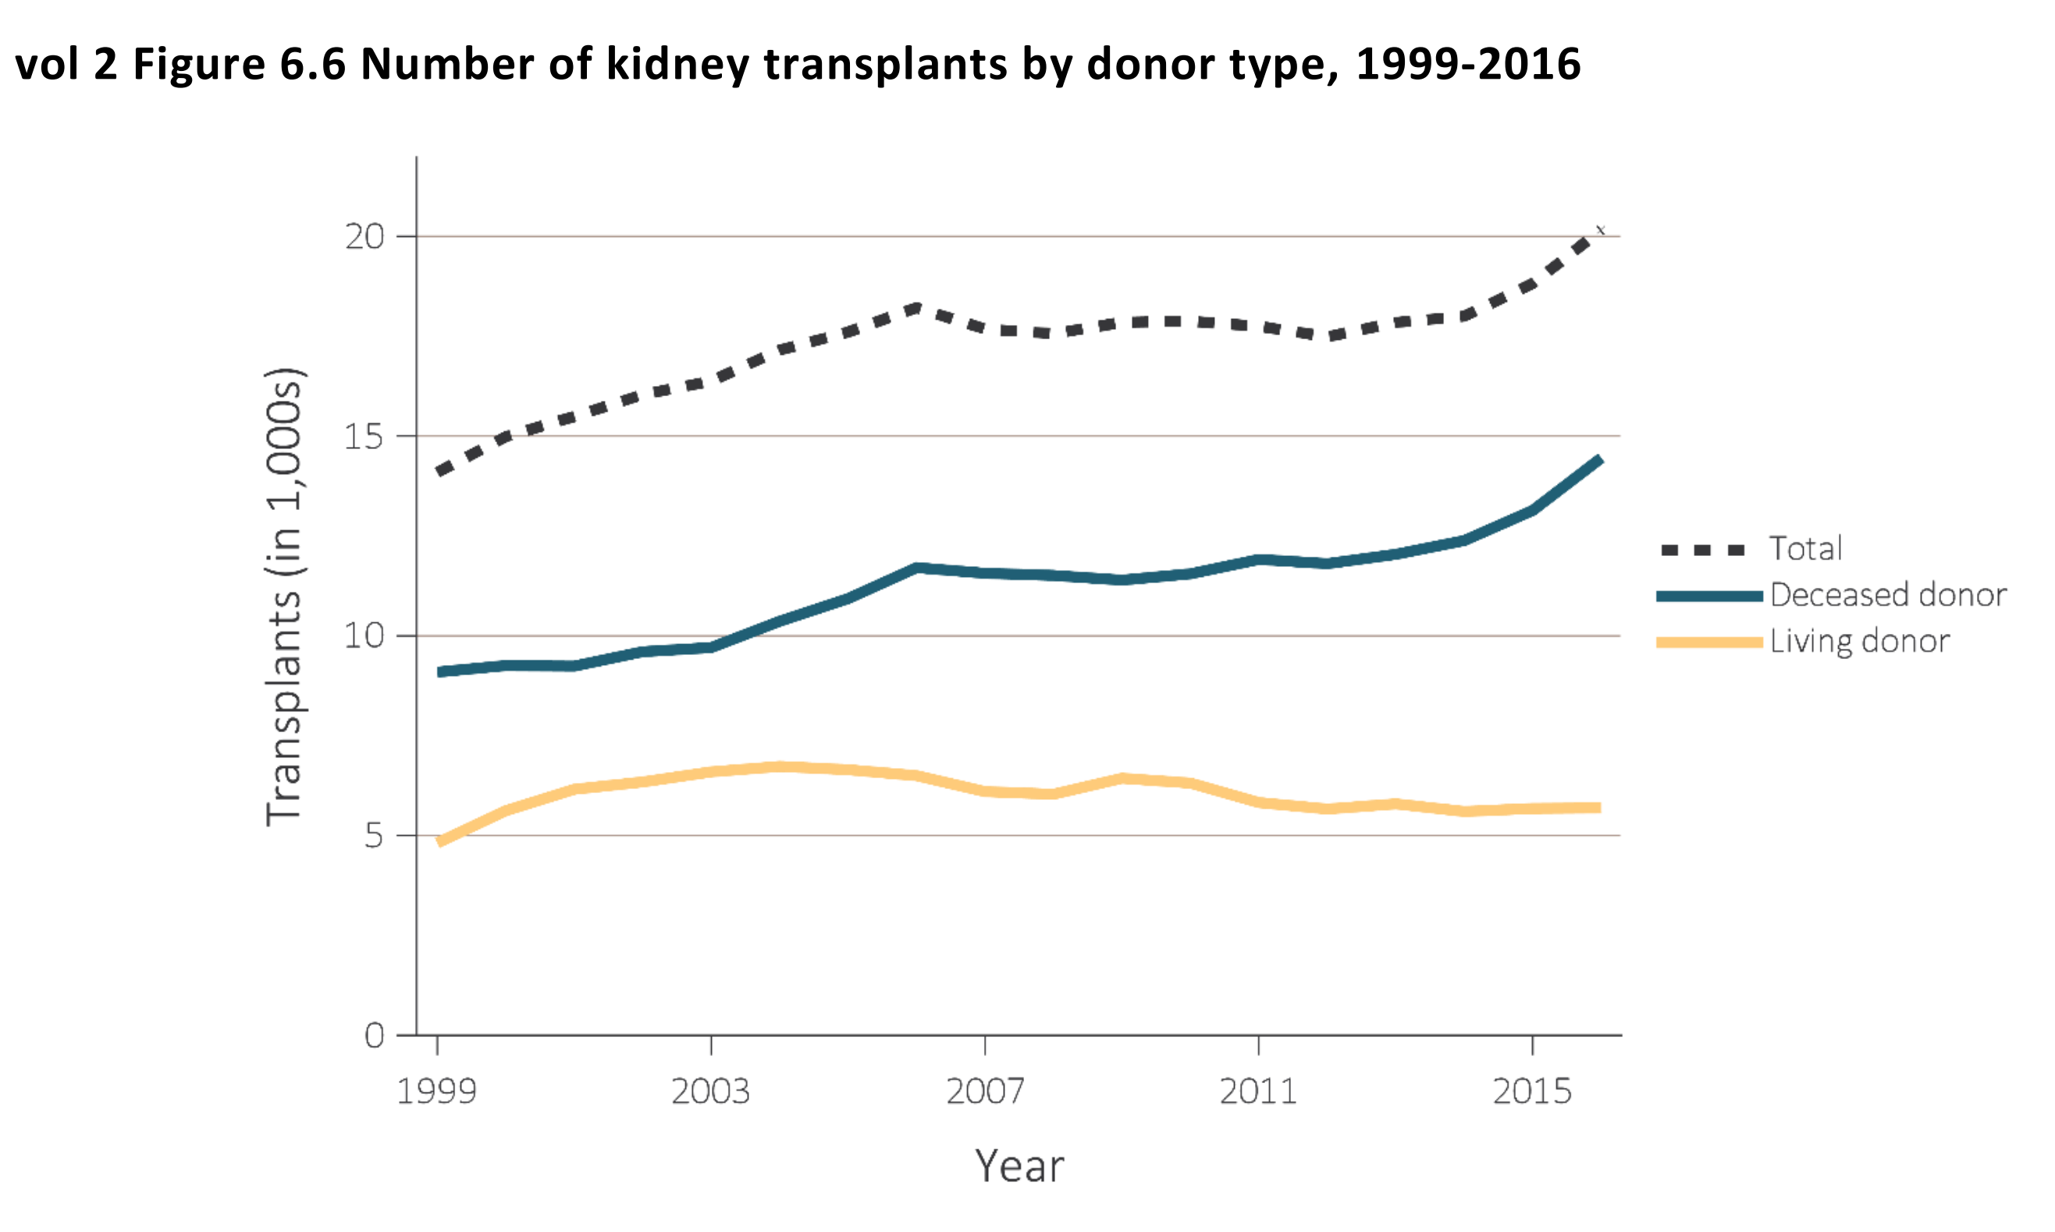
Kidney Supply
In 2008,
10,526 patients
received cadaver kidneys.
4,857 patients
received live donor kidneys.
[1] United States Renal Data System. URL: https://www.usrds.org/adr.aspx. 2019.

Slide 8
Negative Results
In 2008
5,920 patients died
or became too sick for a transplant.
[1] United States Renal Data System. URL: https://www.usrds.org/adr.aspx. 2019.

Slide 9
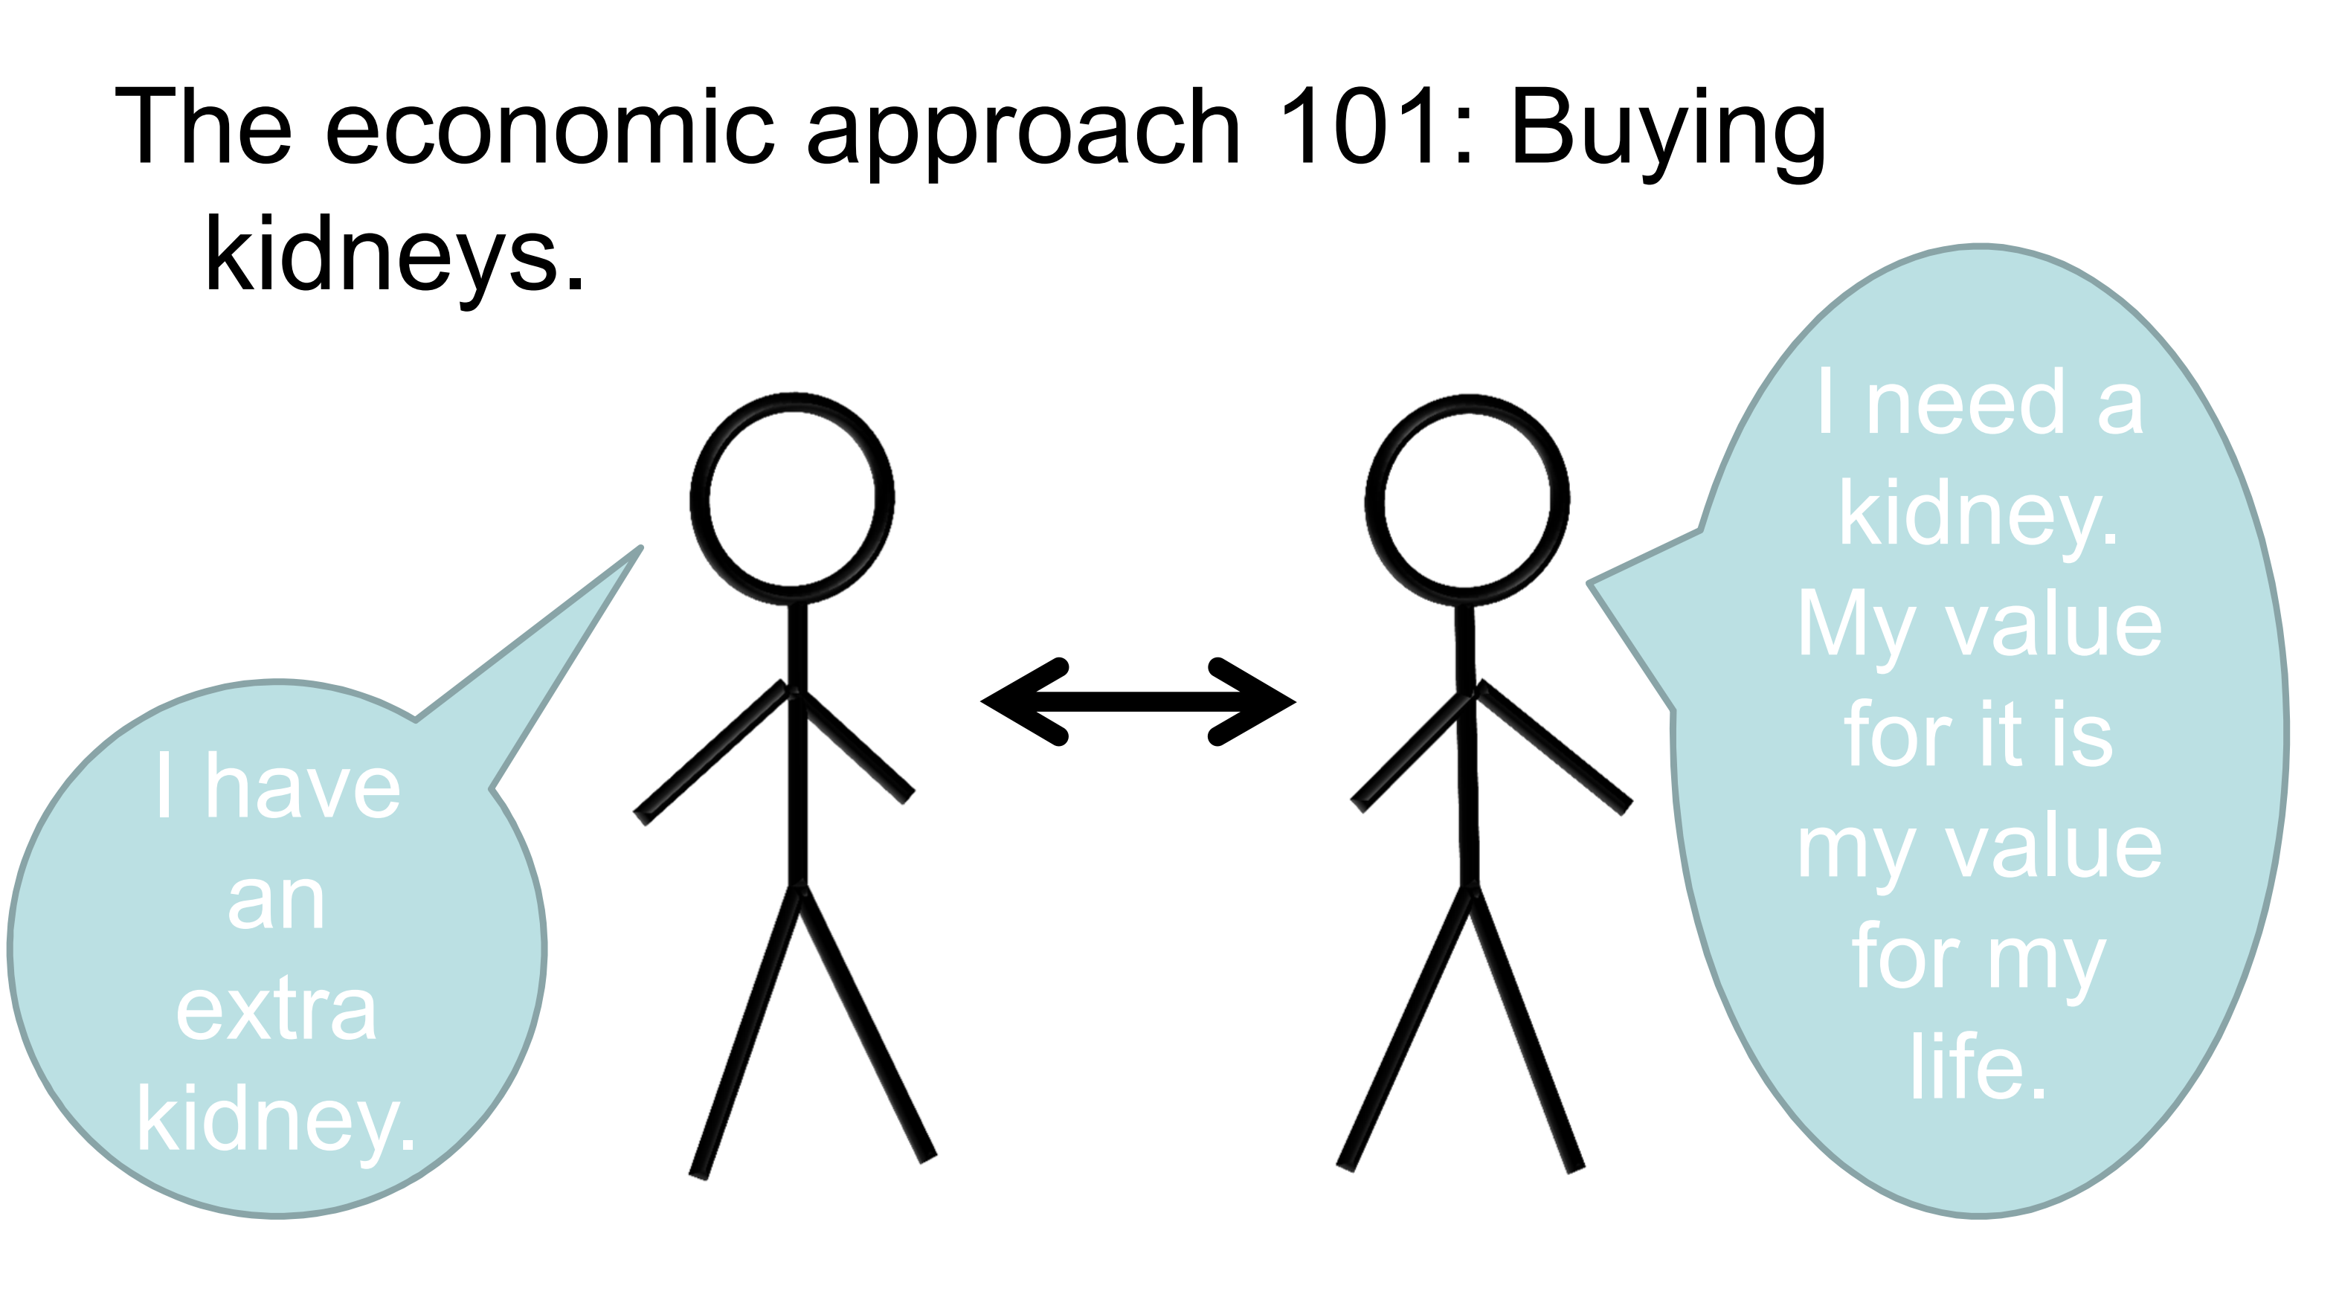
Making Supply Meet Demand
The economic approach 101: Buying Kidneys.

Slide 10
Making Supply Meet Demand
The economic approach 101: Buying Kidneys.
It is not legal according to the Section 301 of the National Organ Transplant Act
“Prohibition of organ purchases” imposes criminal penalties on any person who “knowingly acquire[s], receive[s], or otherwise transfer[s] any human organ for valuable consideration for use in human transplantation.

Slide 11

Grey’s anatomy

Slide 12
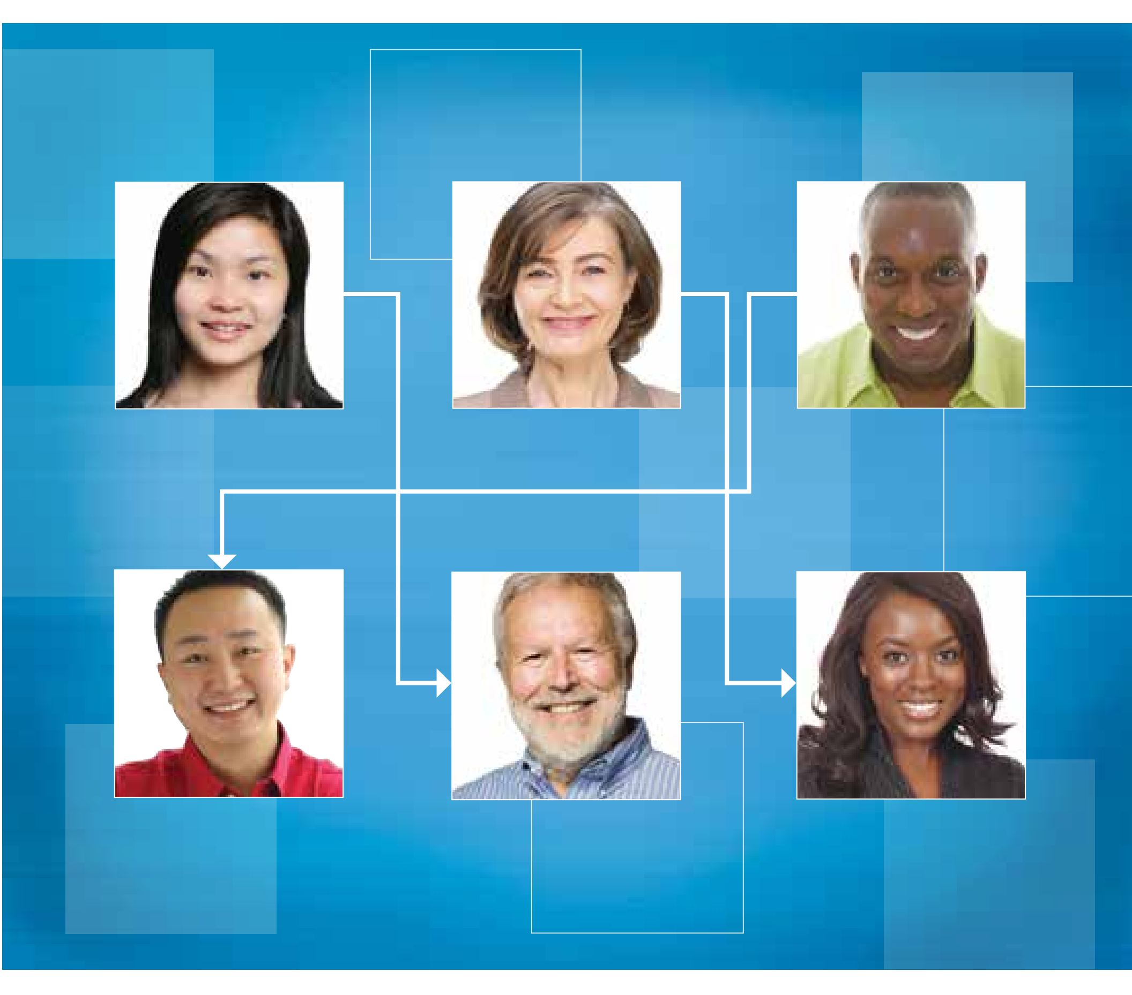
Season 5, episode 5
Dr. Bailey arranges a 6-person kidney exchange. One of donors finds out her husband is cheating
Wants to back out
Persuade her to come back
Dr. Grey drops one of the kidneys on the ground
“5-second rule…”

Slide 13
The Real-world Kidney Exchange
A kidney exchange is an innovative twist on efforts aimed at increasing the donor pool by giving people who are unable to receive a kidney from a loved one or friend the opportunity to still receive a kidney through an exchange between incompatible donor-recipient pairs.
[1] UCLA Kidney Exchange. URL: https://www.uclahealth.org/transplants/kidney-exchange/about-us. 2019.

Slide 14
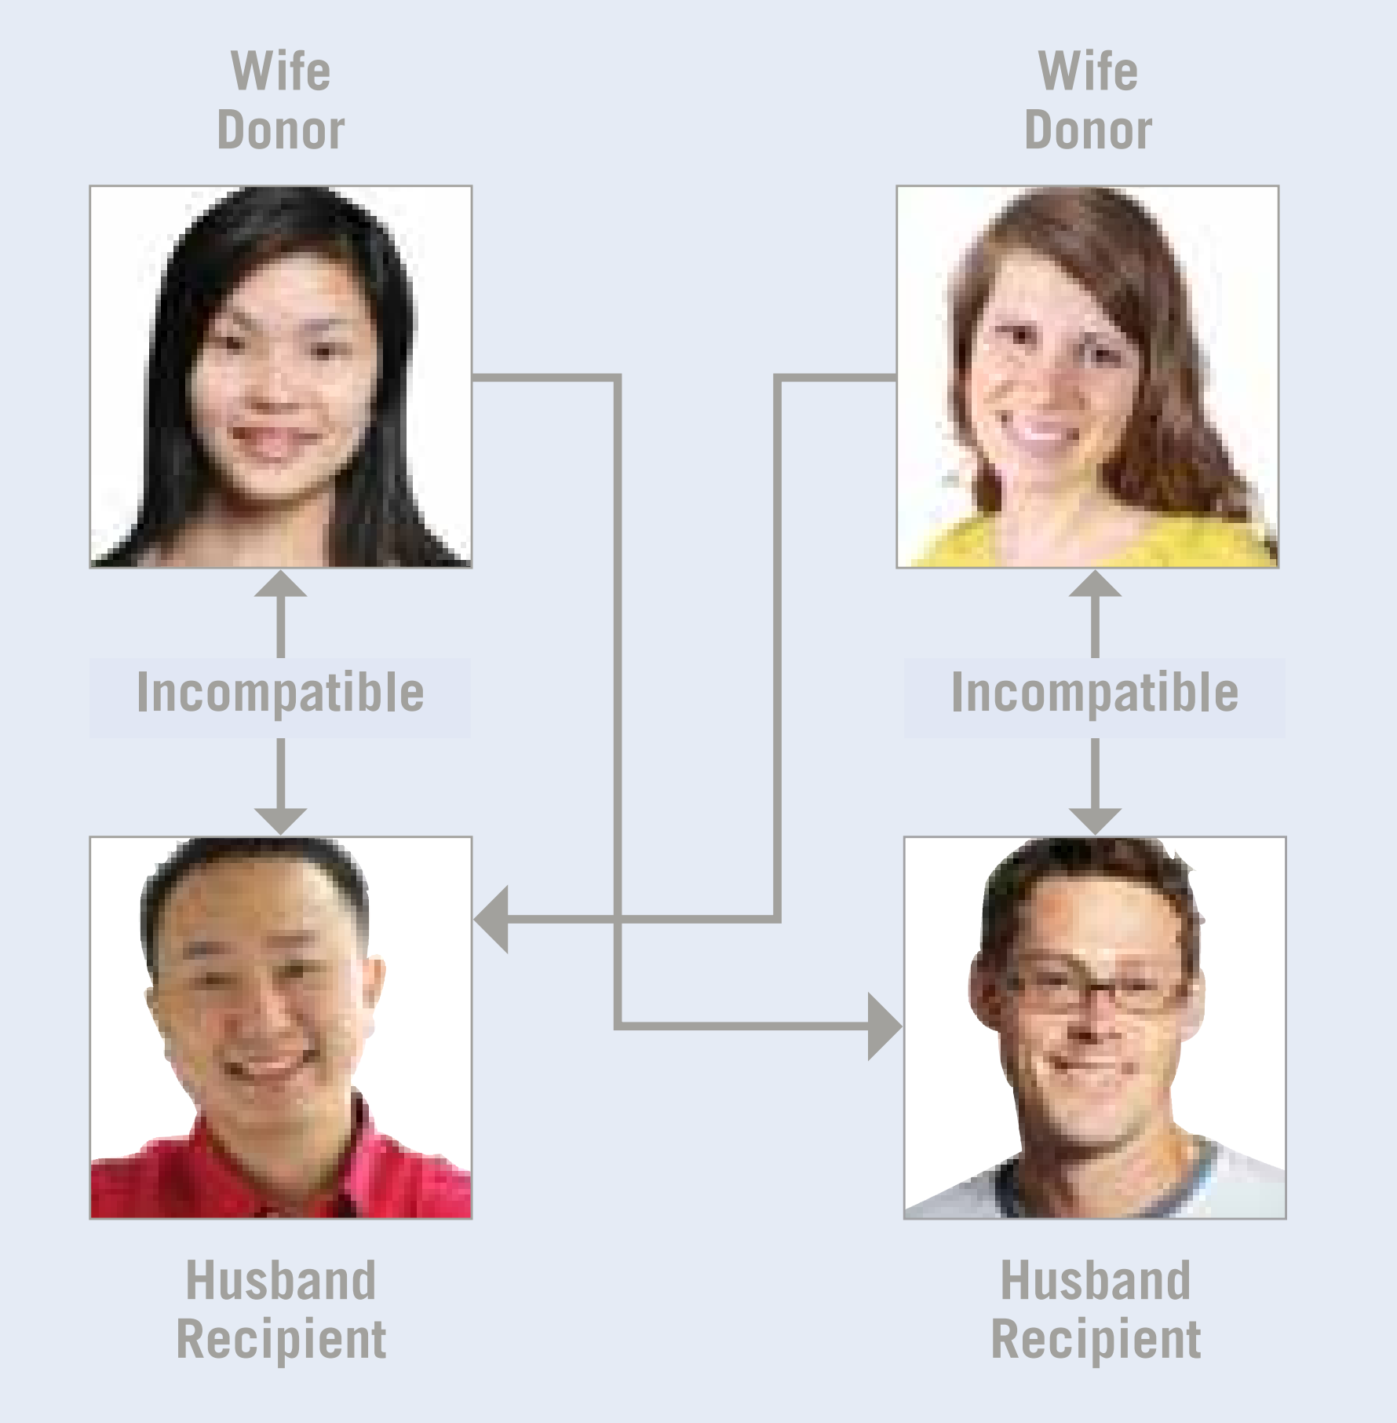
The Real-world Kidney Exchange
Two types of kidney exchanges are possible
Paired Donor Exchange Transplantation (SWAP)
If a donor and recipient have a different blood type, they can exchange their kidneys with another donor and recipient pair in a similar situation.
This can also be done among three pairs.
[1] UCLA Kidney Exchange. URL: https://www.uclahealth.org/transplants/kidney-exchange/about-us. 2019.

Slide 15
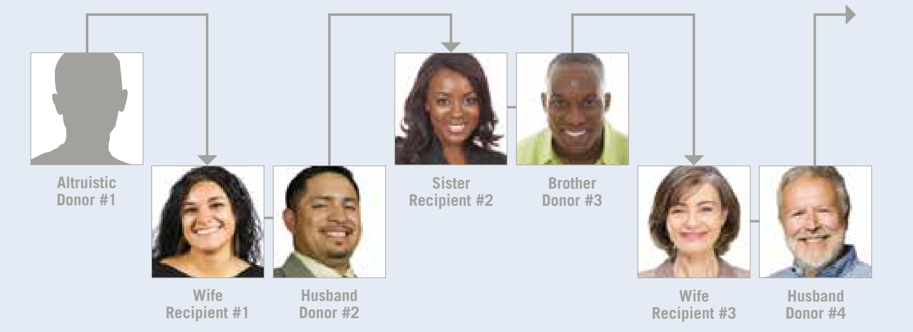
The Real-world Kidney Exchange
Two types of kidney exchanges are possible
Chain Transplantation
It starts with an altruistic donor —someone who wants to donate a kidney out of the goodness of his or her heart.
To keep the chain going, the incompatible donor gives a kidney to a patient unknown to him or her who has been identifed as a match, essentially “paying it forward.”
[1] UCLA Kidney Exchange. URL: https://www.uclahealth.org/transplants/kidney-exchange/about-us. 2019.

Slide 16
The Real-world Kidney Exchange
Benefits:
Receive a kidney sooner, maybe before requiring dialysis
Receive a living donor kidney, whic on average lasts longer than a decease donor kidney
Receive a better matched kidney, which would potentially require fewer drugs and last longer
Provides a very rewarding experience for the donor since multiple families are helped by the donation

Slide 17
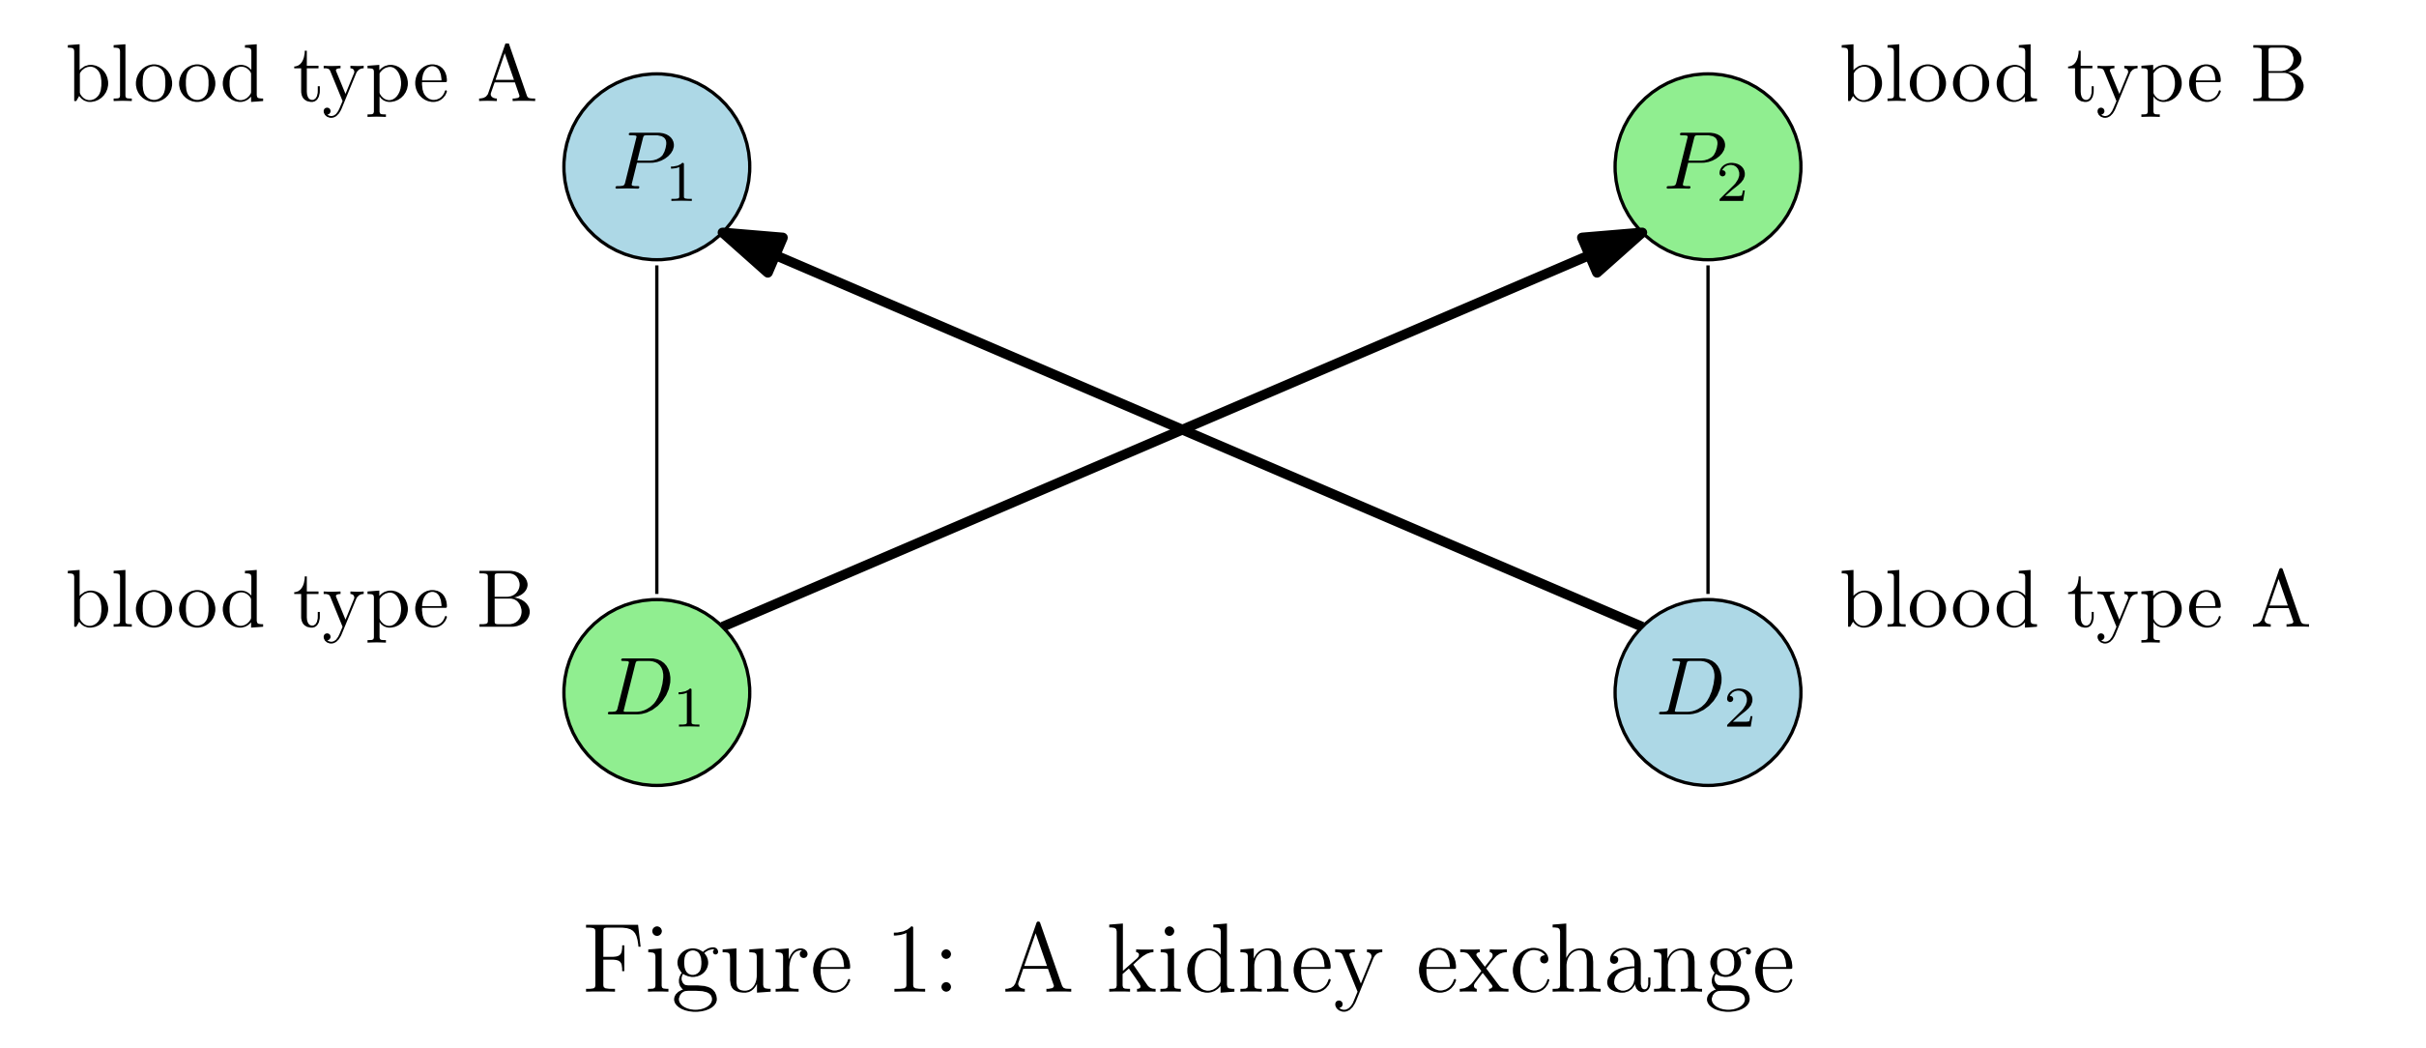
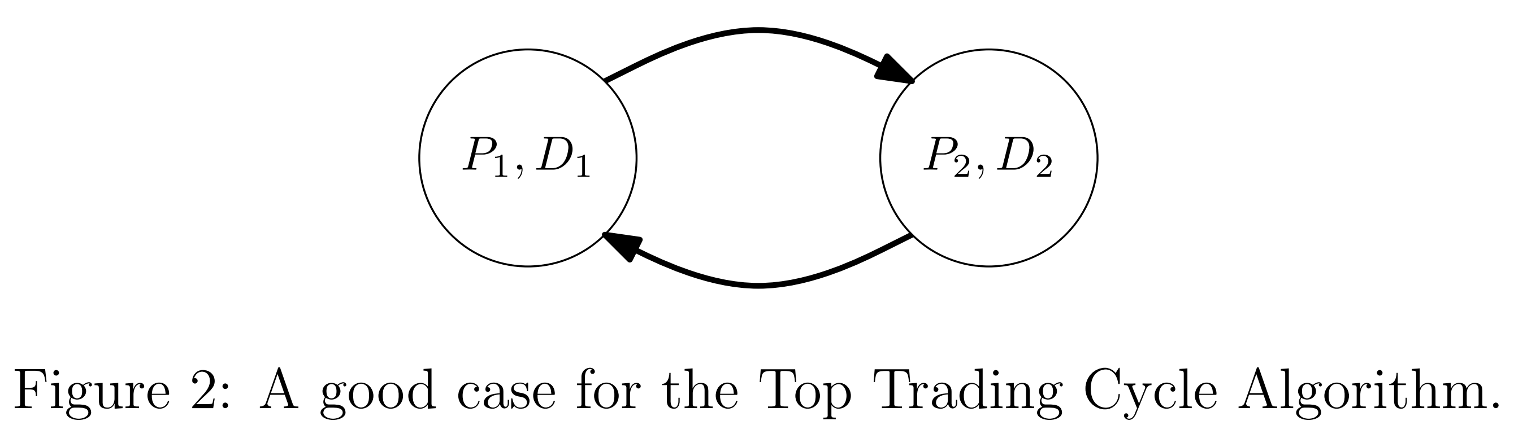
Kidney Exchange Solution: Idea #1: Top Trading Cycle Algorithm
Pretend the kidney is a house.

Slide 18
Kidney Exchange Solution: Idea #1: Top Trading Cycle Algorithm
Limitation1:
The longer cycles in the TTCA indicates more surgeries that must happen simultaneously.
For example, consider a cycle of length two, four surgeries are needed, i.e., two to extract donors’ kidneys, and two to implant them in the patients.

Slide 19
Kidney Exchange Solution: Idea #1: Top Trading Cycle Algorithm
Limitation1:
The longer cycles in the TTCA indicates more surgeries that must happen simultaneously.
For example, consider a cycle of length two, four surgeries are needed, i.e., two to extract donors’ kidneys, and two to implant them in the patients.
Limitation2:
Modeling preferences as a total ordering over the set of living donors is overkill: empirically, patients don’t really care which kidney they get as long as it is compatible

Slide 20
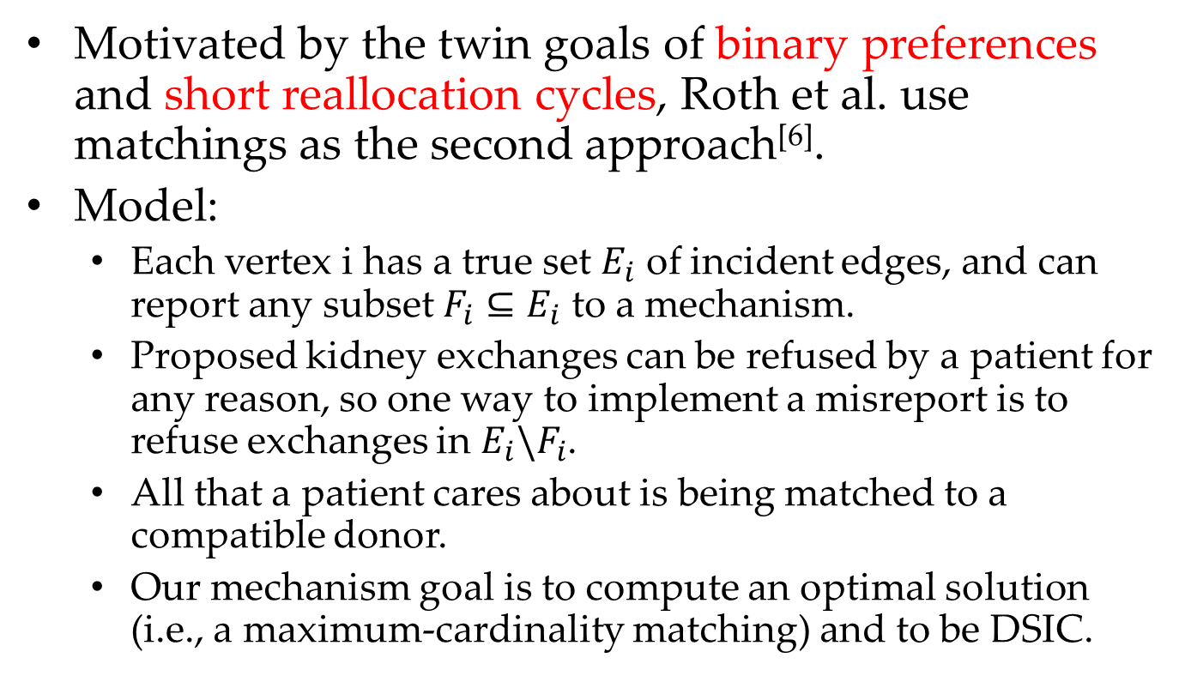
Kidney Exchange Solution: Idea #2: A Matching Algorithm
Motivated by the twin goals of binary preferences and short reallocation cycles, Roth et al. use matchings as the second approach^{[6]}.
Model:
Each vertex i has a true set $E_{i}$ of incident edges, and can report any subset $F_{i}⊆E_{i}$ to a mechanism.
Proposed kidney exchanges can be refused by a patient for any reason, so one way to implement a misreport is to refuse exchanges in $E_{i}\backslash F_{i}$.
All that a patient cares about is being matched to a compatible donor.
Our mechanism goal is to compute an optimal solution (i.e., a maximum-cardinality matching) and to be DSIC.
[6] A. E. Roth, T. Sönmez, and M. U. Ünver. Pairwise kidney exchange. Journal of Economic Theory, 125:151-188, 2005.

Slide 21
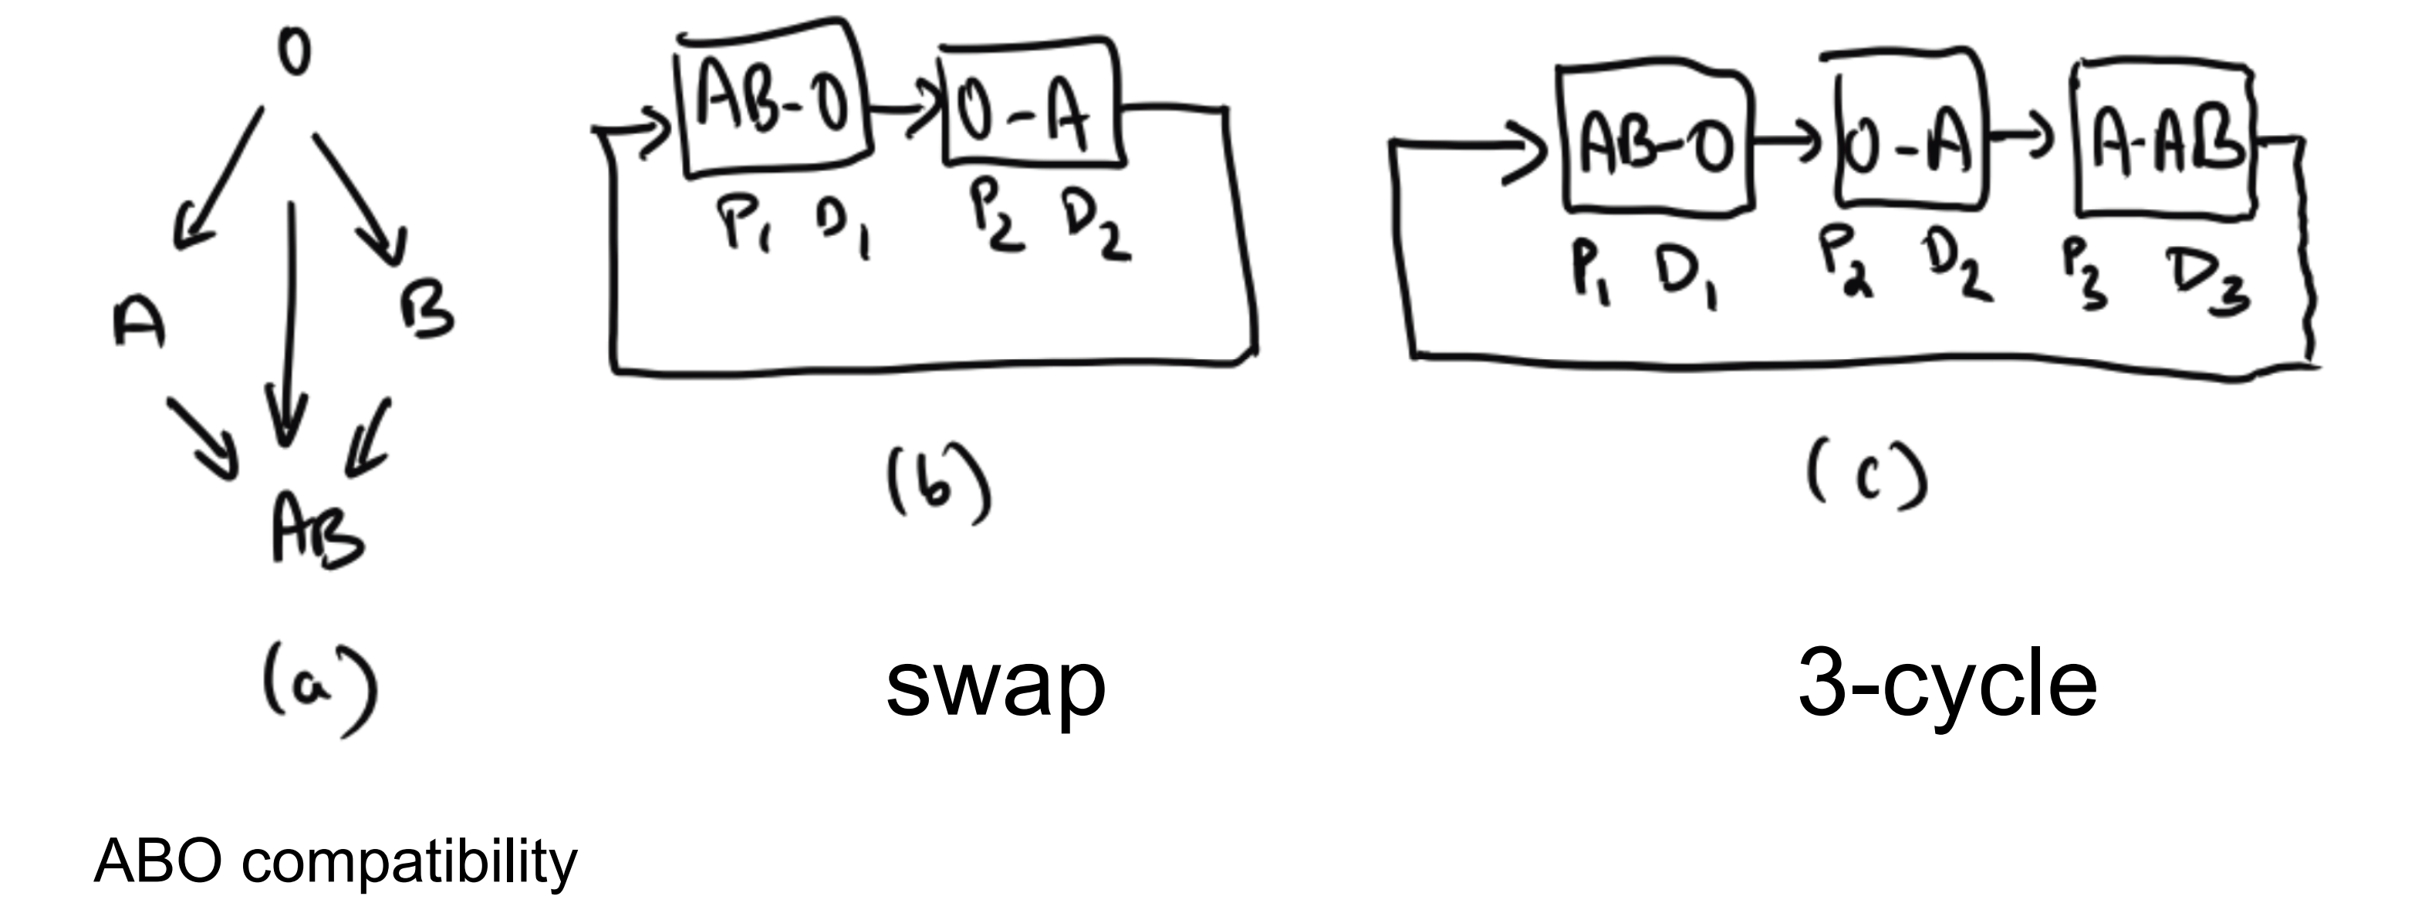
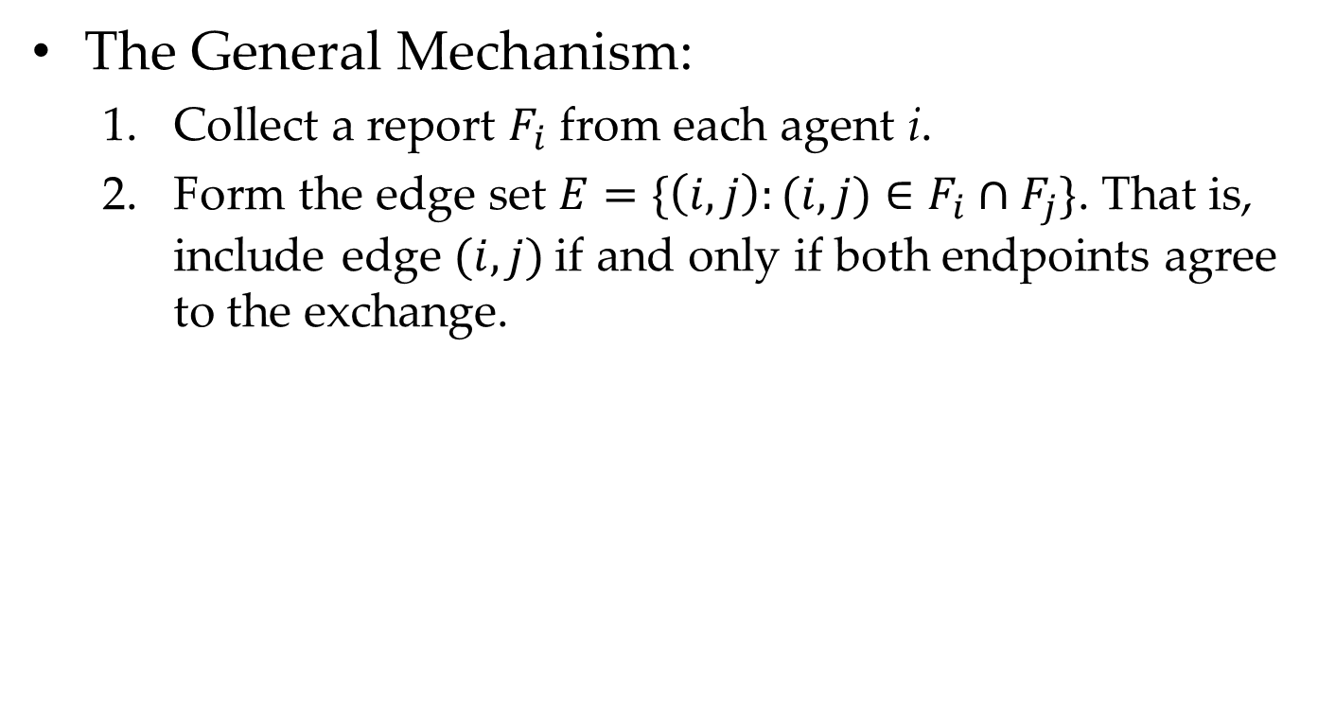
Kidney Exchange Solution: Idea #2: A Matching Algorithm
The General Mechanism:
Collect a report $F_{i}$ from each agent i.
Form the edge set $E=\{\left(i,j\right):(i,j)∈F_{i}∩F_{j}\}$. That is, include edge $(i, j)$if and only if both endpoints agree to the exchange.

Slide 22
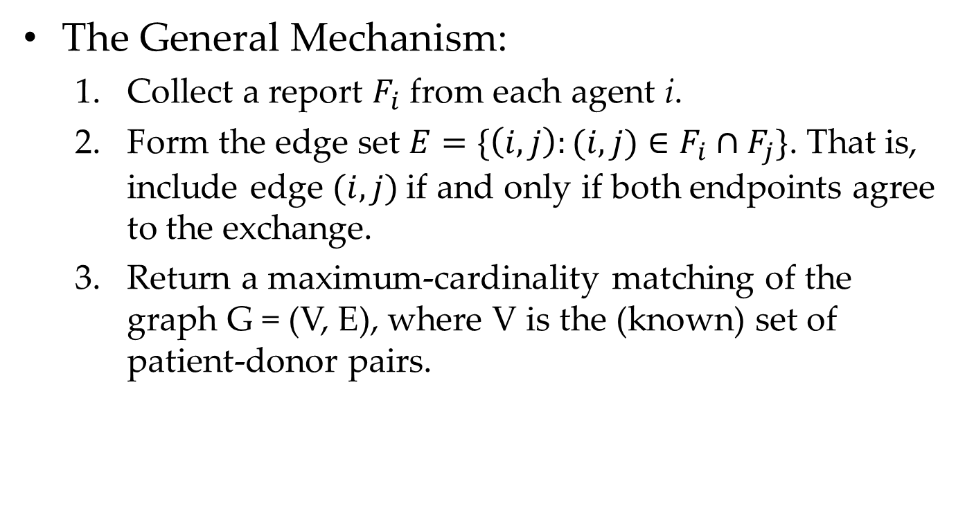
Kidney Exchange Solution: Idea #2: A Matching Algorithm
The General Mechanism:
Collect a report $F_{i}$ from each agent i.
Form the edge set $E=\{\left(i,j\right):(i,j)∈F_{i}∩F_{j}\}$. That is, include edge $(i, j)$if and only if both endpoints agree to the exchange.
Return a maximum-cardinality matching of the graph G = (V, E), where V is the (known) set of patient-donor pairs.

Slide 23
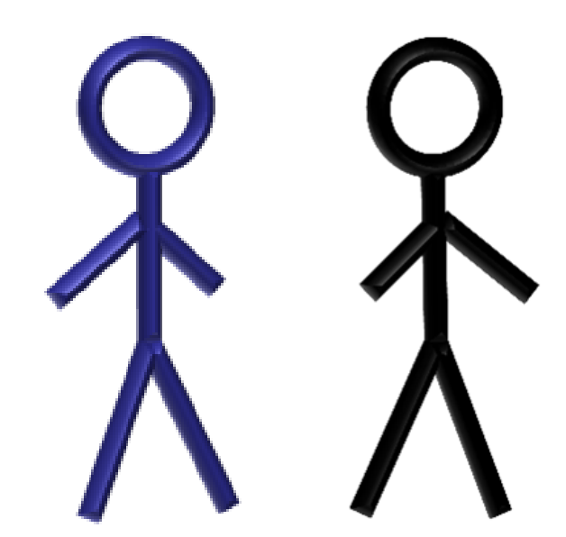
Kidney Exchange Solution: Idea #2: A Matching Algorithm
Sick, Blood
A
Sick, Blood
O
Sick, Blood
B
Healthy,
Bood B
Healthy,
Bood A
Healthy,
Bood O
B-A
A-O
O-B

Slide 24
Kidney Exchange Solution: Idea #2: A Matching Algorithm
Sick, Blood
A
Sick, Blood
O
Sick, Blood
B
Healthy,
Bood B
Healthy,
Bood A
Healthy,
Bood O
B-A
A-O
O-B
B-A
A-O
O-B

Slide 25
Kidney Exchange Solution: Idea #2: A Matching Algorithm
Sick, Blood
A
Sick, Blood
O
Sick, Blood
B
Healthy,
Bood B
Healthy,
Bood A
Healthy,
Bood O
The maximum cardinality is 3.
B-A
A-O
O-B
B-A
A-O
O-B

Slide 26
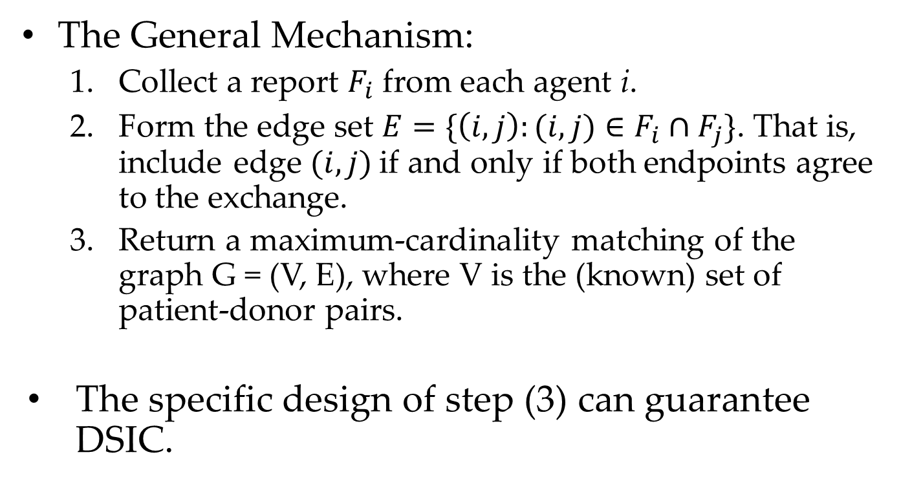
Kidney Exchange Solution: Idea #2: A Matching Algorithm
The General Mechanism:
Collect a report $F_{i}$ from each agent i.
Form the edge set $E=\{\left(i,j\right):(i,j)∈F_{i}∩F_{j}\}$. That is, include edge $(i, j)$if and only if both endpoints agree to the exchange.
Return a maximum-cardinality matching of the graph G = (V, E), where V is the (known) set of patient-donor pairs.
The specific design of step (3) can guarantee DSIC.

Slide 27
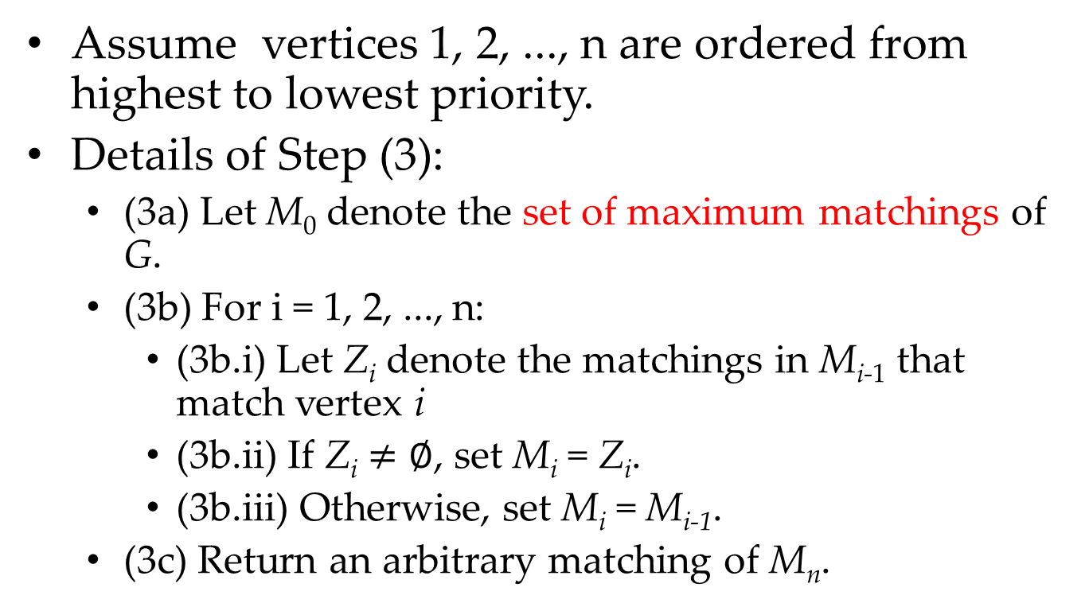
Kidney Exchange Solution: Idea #2: A Matching Algorithm
Assume vertices 1, 2, ..., n are ordered from highest to lowest priority.
Details of Step (3):
(3a) Let M₀ denote the set of maximum matchings of G.
(3b) For i = 1, 2, ..., n:
(3b.i) Let Z_{i} denote the matchings in M_{i-1} that match vertex i
(3b.ii) If Z_{i} $≠∅$, set M_{i} = Z_{i}.
(3b.iii) Otherwise, set M_{i} = M_{i-1}.
(3c) Return an arbitrary matching of M_{n}.
Question 1. What is the time complexity of the matching based algorithm?

Slide 28
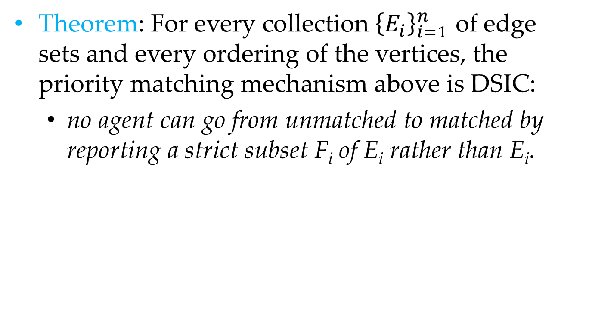
Kidney Exchange Solution: Idea #2: A Matching Algorithm
Theorem: For every collection ${\left\{E_{i}\right\}}_{i=1}^{n}$ of edge sets and every ordering of the vertices, the priority matching mechanism above is DSIC:
no agent can go from unmatched to matched by reporting a strict subset F_{i} of E_{i} rather than E_{i}.
Question 2. What is the formal proof of the DSIC property?

Slide 29
Cutting-Edge Challenges
Current research is focused on incentive problems at the hospital level, rather than at the level of individual patient-donor pairs.
This change is well motivated because many patientdonor pairs are reported to national kidney exchanges by hospitals, rather than by the pairs themselves.

Slide 30
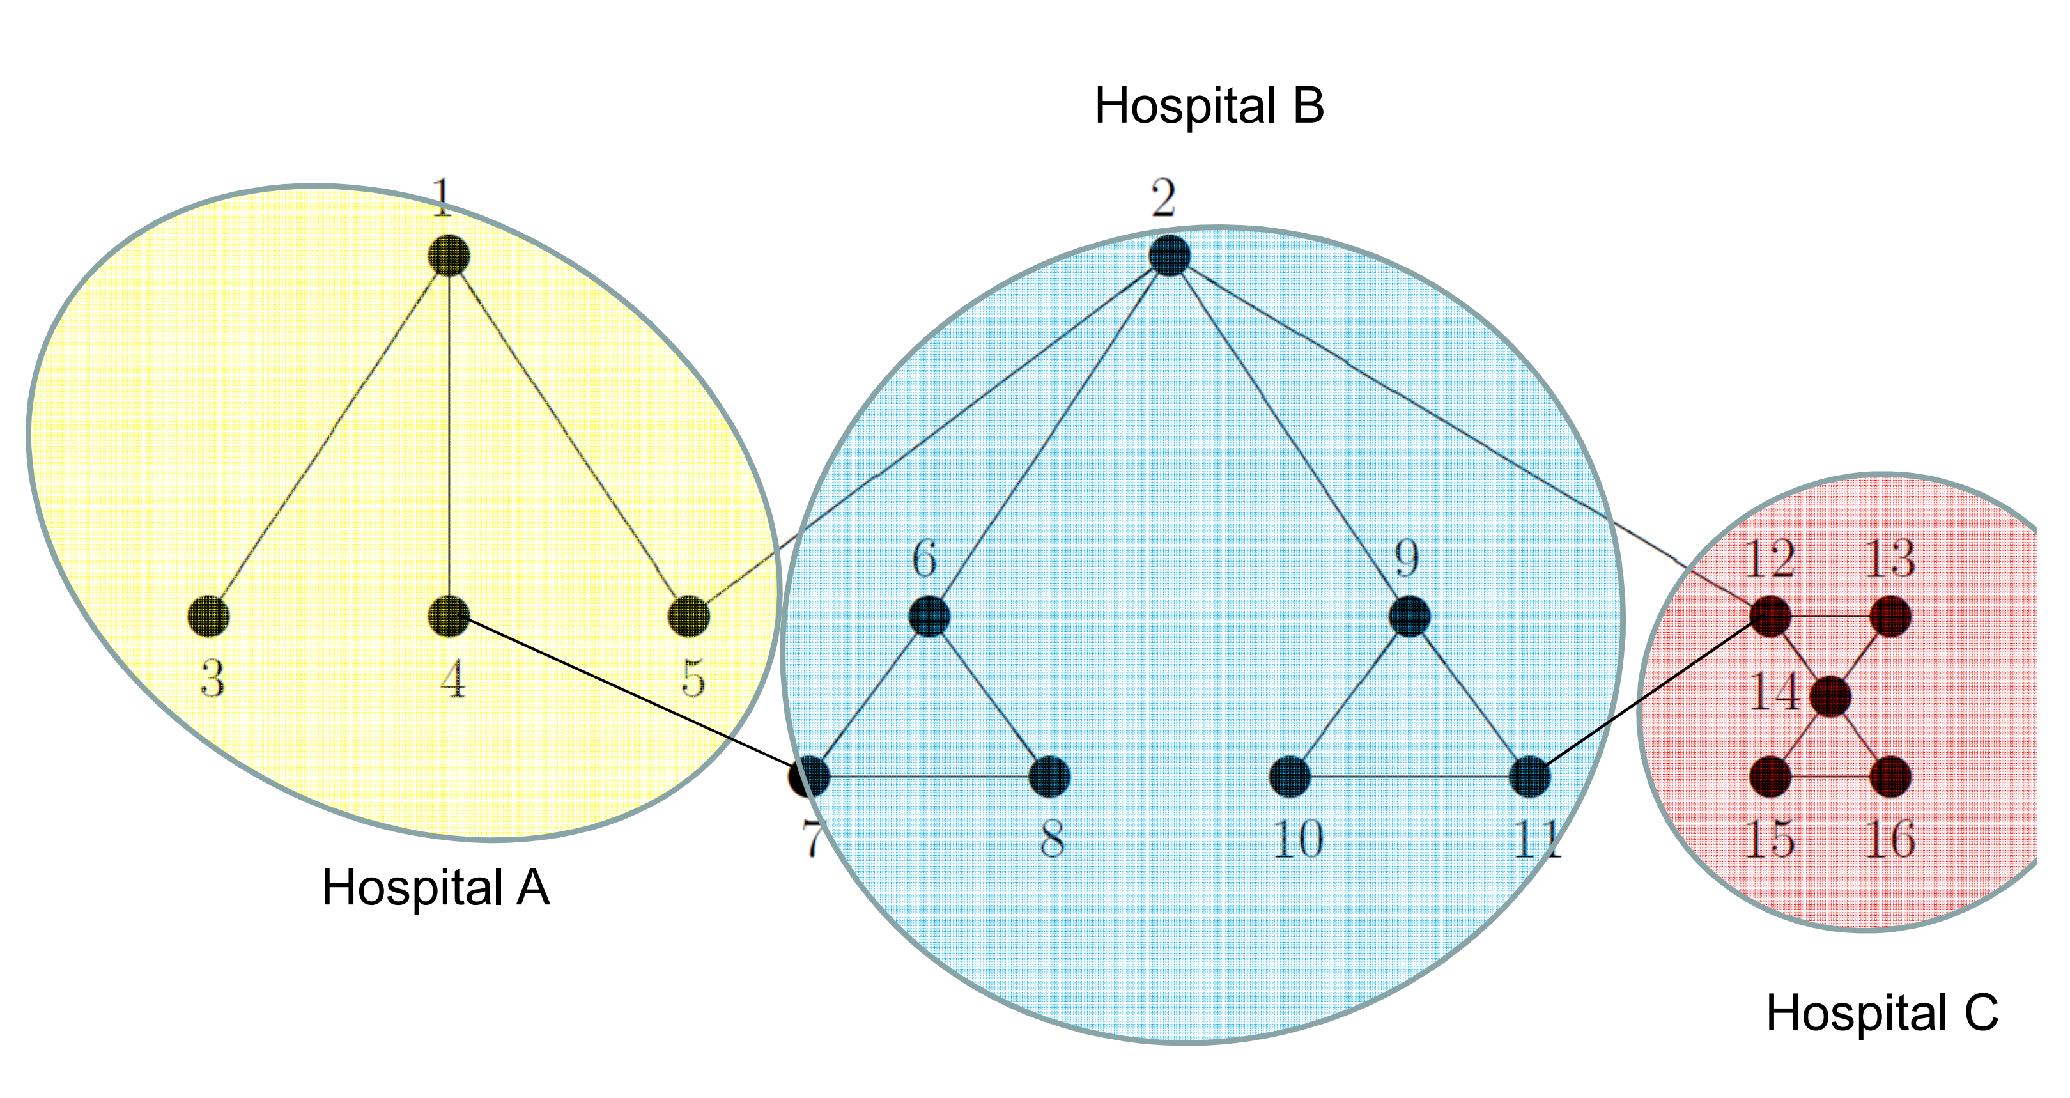
Multi-hospital Incentives

Slide 31
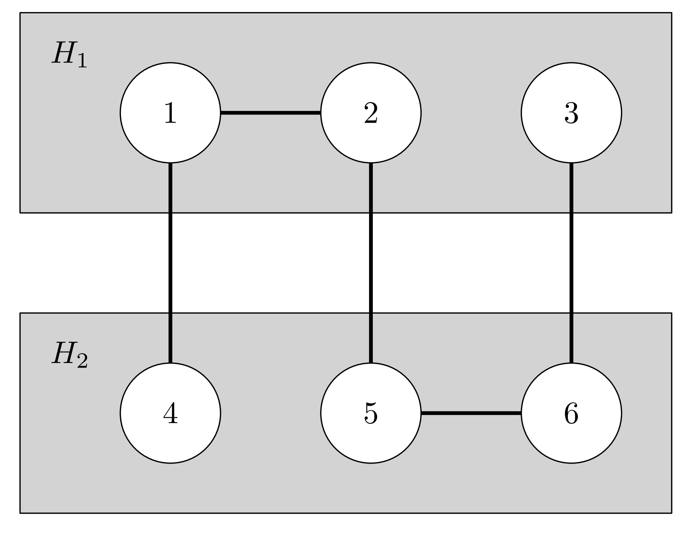
The Need for Full Reporting
Example 1:
Suppose there are two hospitals and the compatible donations are as follows.
The local matching cardinality is 2.

Slide 32
The Need for Full Reporting
Example 1:
Suppose there are two hospitals and the compatible donations are as follows.
The global matching cardinality is 3.
Both hospitals
are happy.

Slide 33
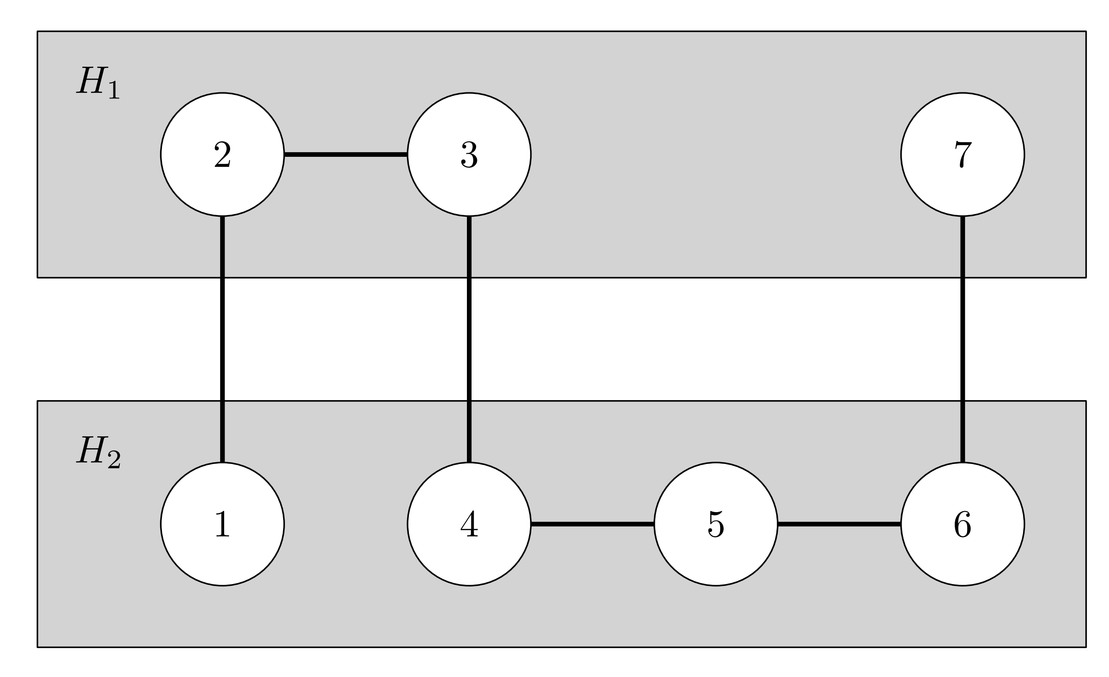
The Need for Full Reporting
Example 2:
Suppose there are two hospitals and the compatible donations are as follows.
H1 has the incentive to hide
(2,3).
H2 is then not fully matched.

Slide 34
The Need for Full Reporting
Example 2:
Suppose there are two hospitals and the compatible donations are as follows.
H1 is then not fully matched.
H2 has the incentive to hide
(5,6).

Slide 35
Worst-case Negative result
Theorem: No deterministic, truthful mechanism can provide an approximation ratio better than 2^{[1]}
[1] Itai Ashlagi, Felix A. Fischer, Ian A. Kash, Ariel D. Procaccia. Mix and match. In EC, 2010.

Slide 36
Case Study #2: Stable Matching

Slide 37
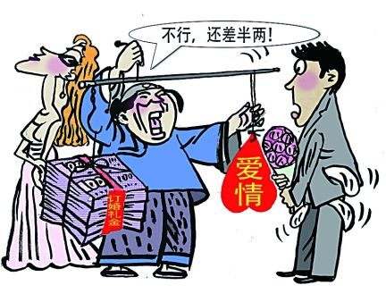
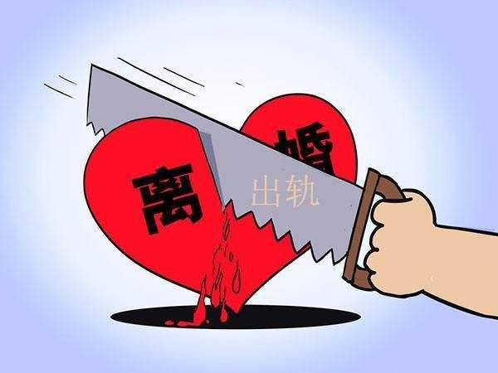
Stable Matching: Background
Stable matching is the canonical example of mechanism design without money.
Killer applications include assigning medical school graduates to hospitals and students to elementary schools.

Slide 38
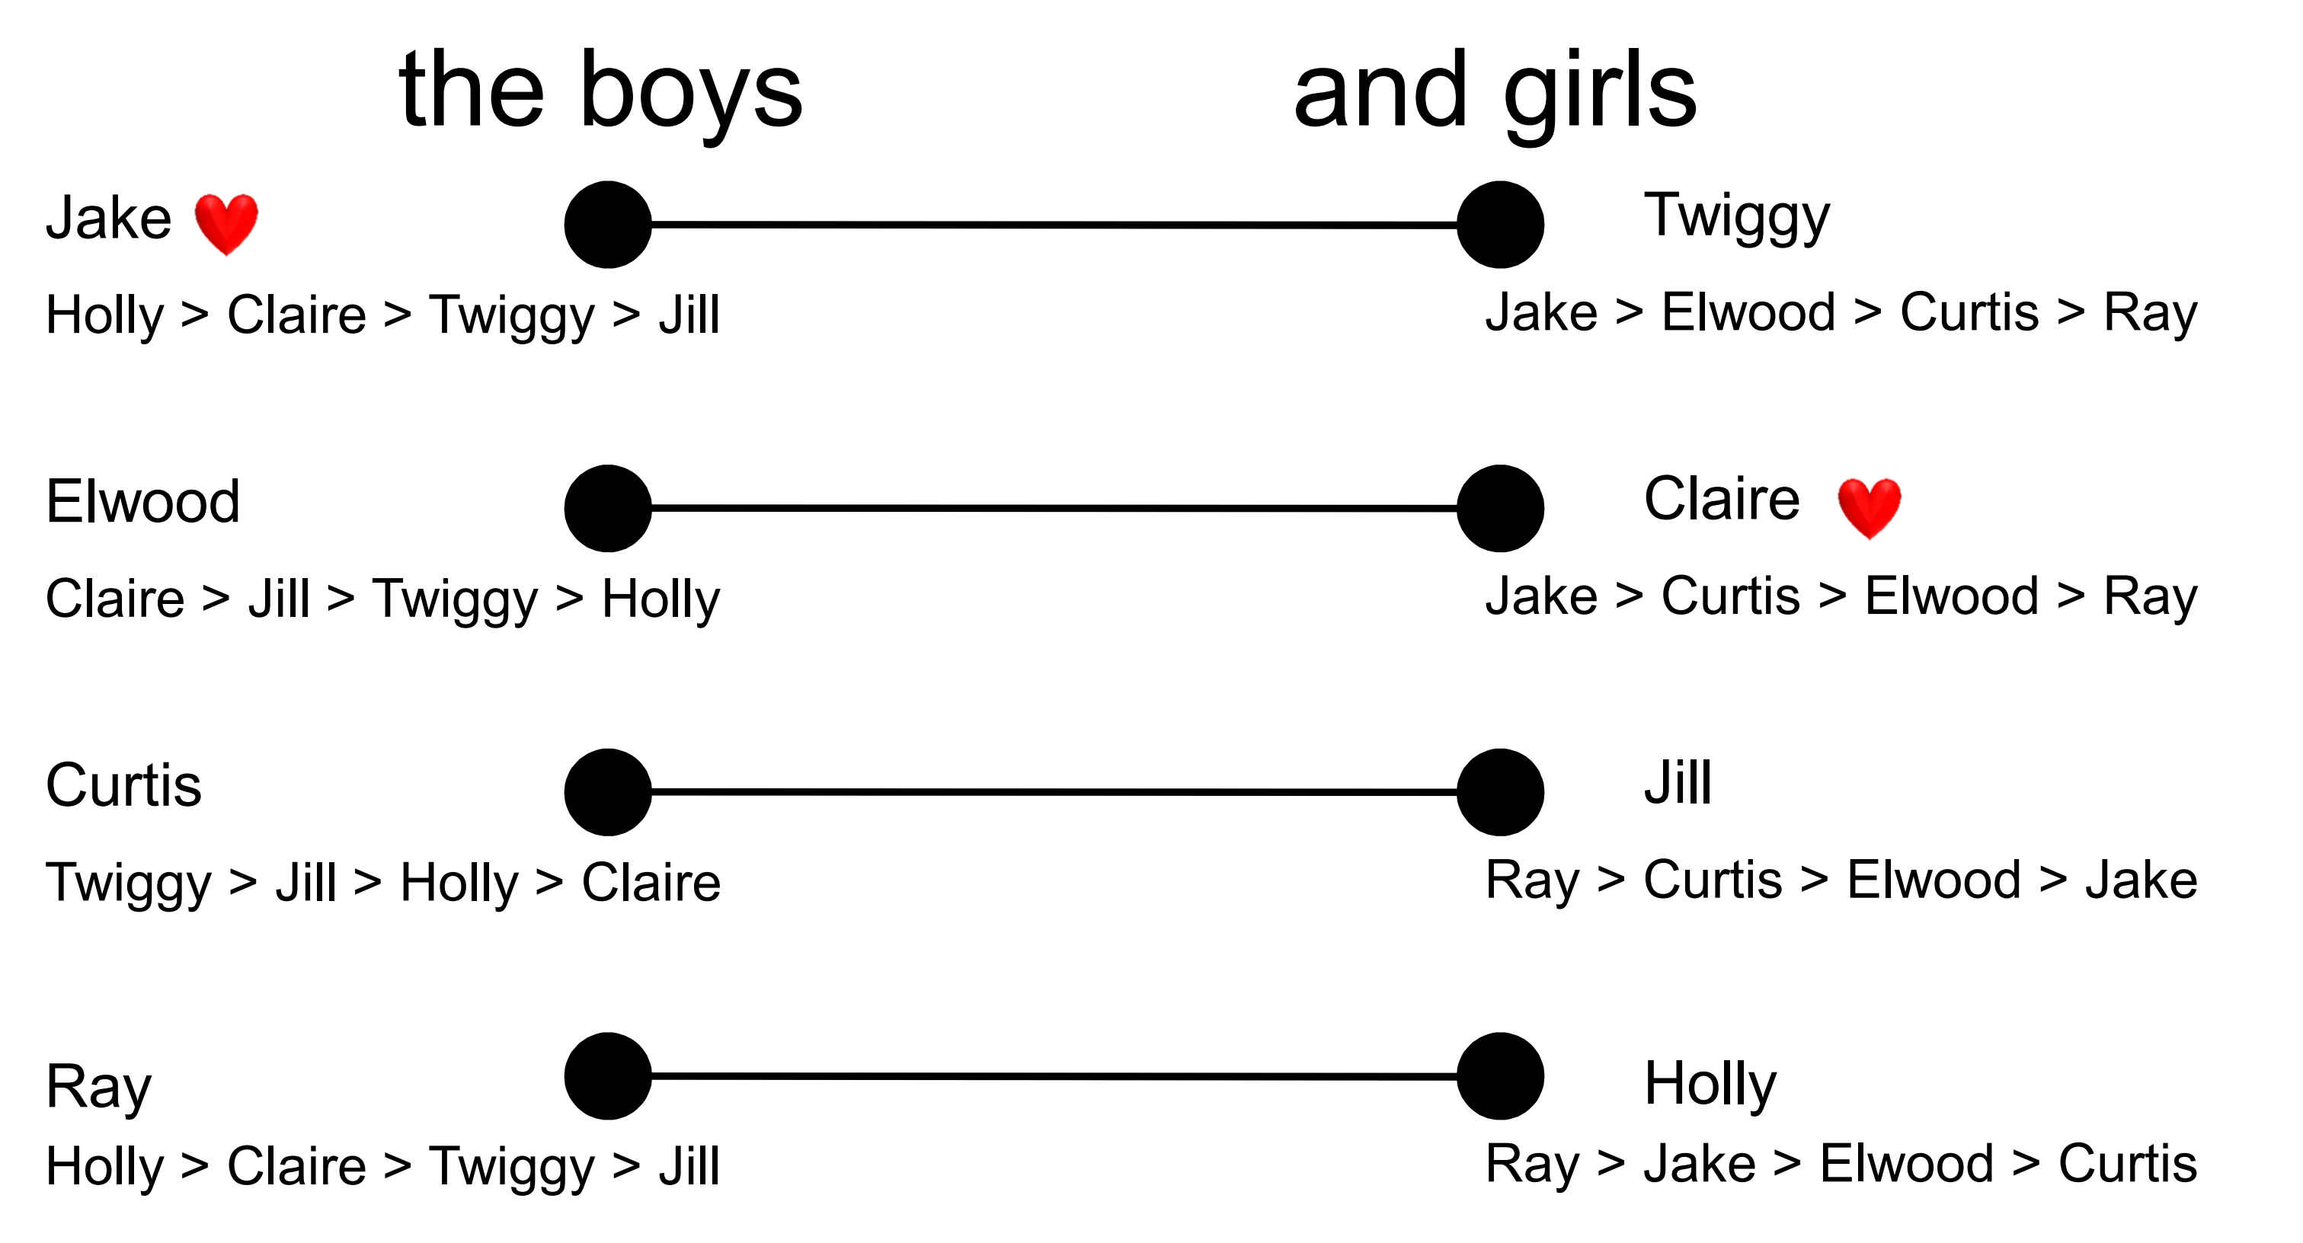

Stable Matching: Model
There are two sets U and V that represent the “men” and “women” with n vertices each.
Each vertex also has a total ordering over the vertices of the other set.

Slide 39
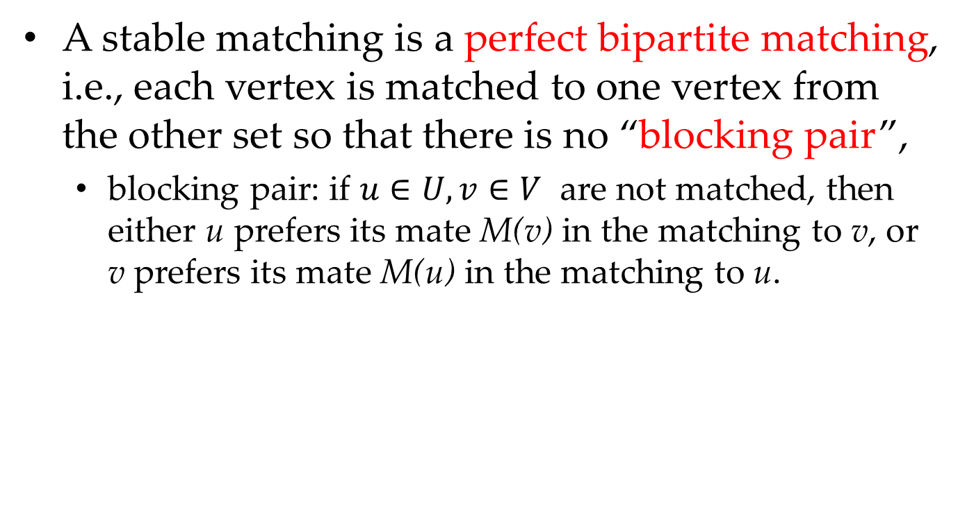
Stable Matching: Model
A stable matching is a perfect bipartite matching, i.e., each vertex is matched to one vertex from the other set so that there is no “blocking pair”,
blocking pair: if $u∈U, v∈V$ are not matched, then either u prefers its mate M(v) in the matching to v, or v prefers its mate M(u) in the matching to u.

Slide 40
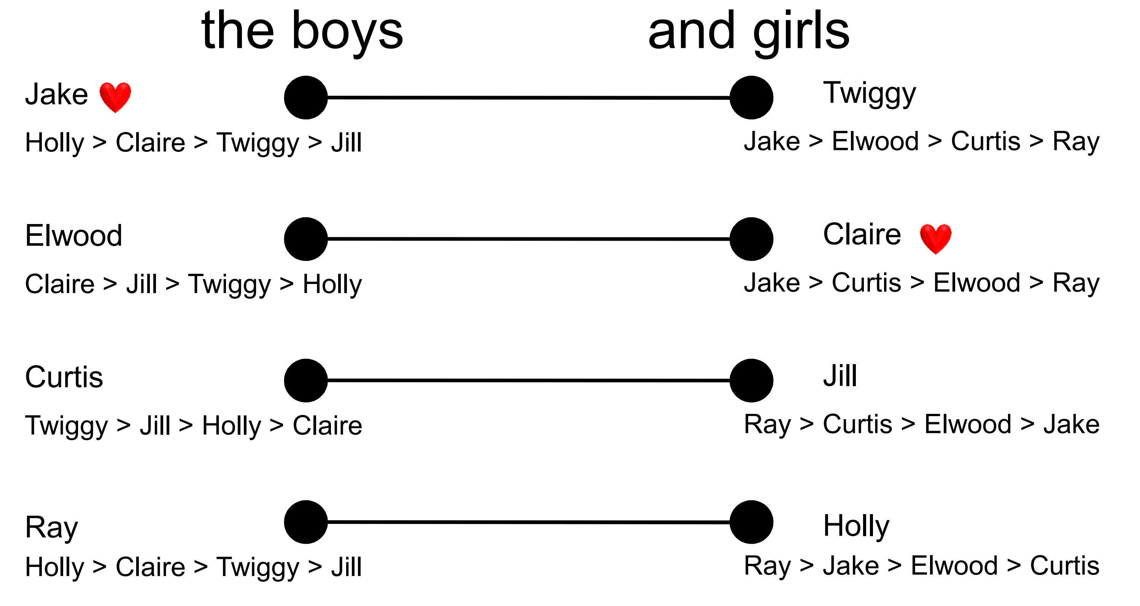
Stable Matching: Model
A stable matching is a perfect bipartite matching, i.e., each vertex is matched to one vertex from the other set so that there is no “blocking pair”

Slide 41
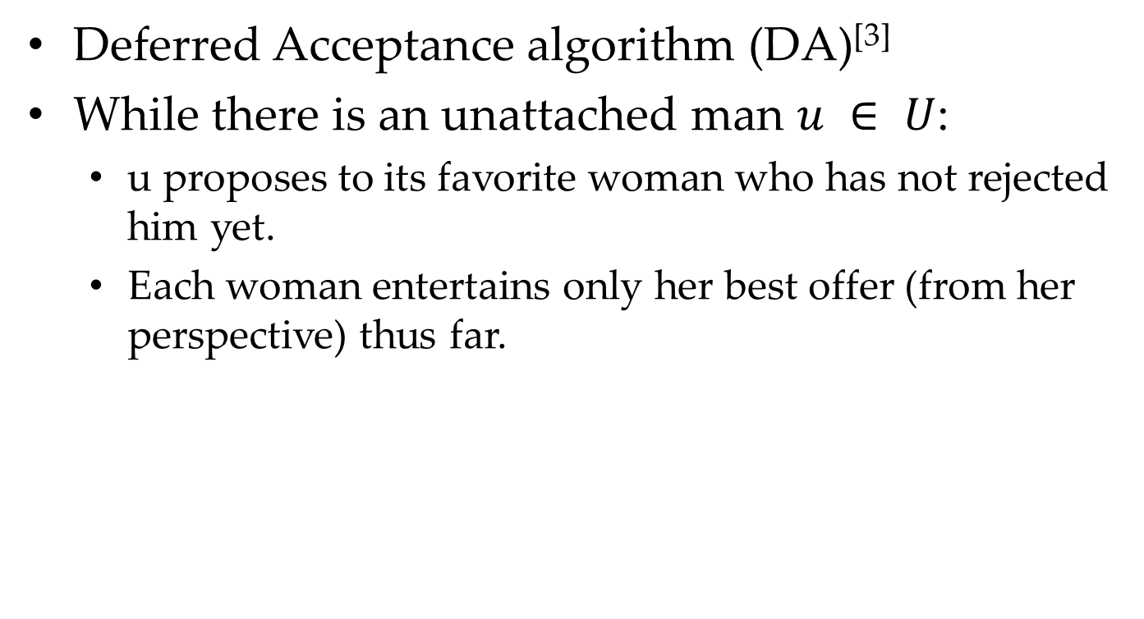
Stable Matching: Algorithm
Deferred Acceptance algorithm (DA)^{[3]}
While there is an unattached man $u ∈ U$:
u proposes to its favorite woman who has not rejected him yet.
Each woman entertains only her best offer (from her perspective) thus far.
[3] D. Gale and L. S. Shapley. College admissions and the stability of marriage. American Mathematical Monthly, 69:9-15, 1962.

Slide 42

Stable Matching: Algorithm
Single Dog: {Jake, Elwood, Curtis, Ray}

Slide 43
Stable Matching: Algorithm
Single Dog: {Jake, Elwood, Curtis, Ray}

Slide 44
Stable Matching: Algorithm
Single Dog: {Elwood, Curtis, Ray}

Slide 45
Stable Matching: Algorithm
Single Dog: {Curtis, Ray}

Slide 46
Stable Matching: Algorithm
Single Dog: {Ray}
Holly prefers Ray than Jake.

Slide 47
Stable Matching: Algorithm
Jake becomes
a single dog again.
Single Dog: {Jake}

Slide 48
Stable Matching: Algorithm
Single Dog: {Jake}
Claire prefers Jake than Elwood.

Slide 49
Stable Matching: Algorithm
Elwood becomes
a single dog again.
Single Dog: {Elwood}

Slide 50
Stable Matching: Algorithm
Single Dog: {Elwood}
Finally, someone loves me.

Slide 51
Stable Matching: Algorithm
Single Dog: {}
We find the stable matching {(J&C), (E&J), (C&T), (R&H)}.

Slide 52
Stable Matching: Questions
Do stable matches exist?
Are they easy to find?
Does stability matter?
Are they unique?
What about incentives?

Slide 53
Existence of a stable match
DA generates a stable match
Sketch:
– if not stable, exists (b,g) blocking pair. – b matched to some g’, prefers g. – b would have proposed to g before g’. – g must be holding b’ she prefers more than b. – (b,g) not a blocking pair. Contradiction.
Any Volunteers ???

Slide 54
Stable Matching: Questions
Do stable matches exist? yes
Are they easy to find?
Does stability matter?
Are they unique?
What about incentives?

Slide 55
Stable Matching: Questions
Do stable matches exist? yes
Are they easy to find? yes
Does stability matter?
Are they unique?
What about incentives?

Slide 56
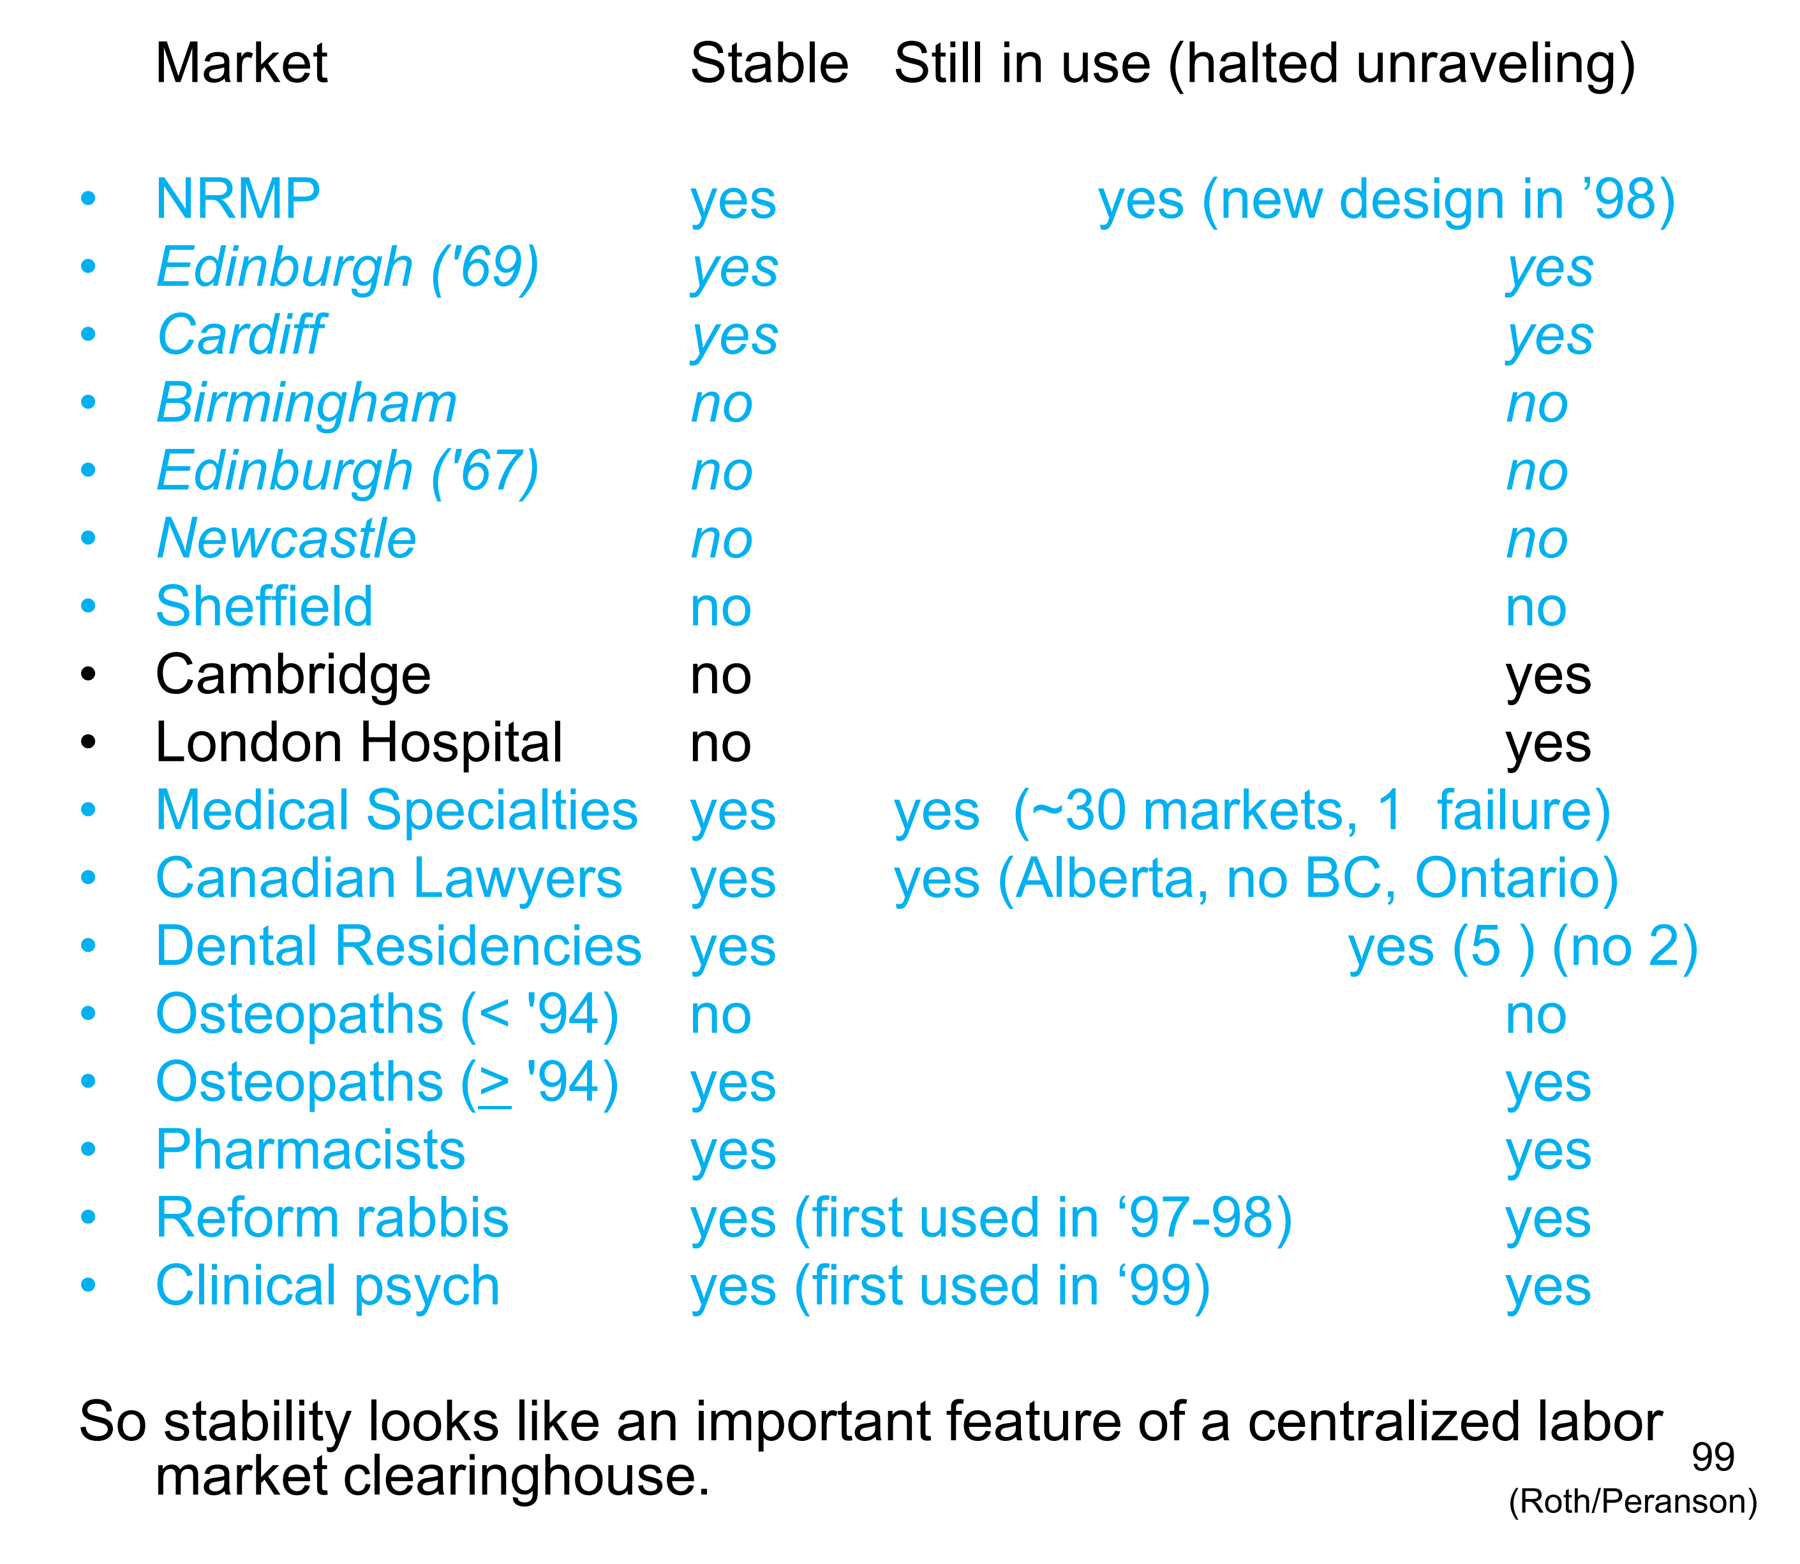
Stable Matching: Questions

Slide 57
Stable Matching: Questions
Do stable matches exist? yes
Are they easy to find? yes
Does stability matter? yes
Are they unique?
What about incentives?

Slide 58
Stable Matching: Questions
Do stable matches exist? yes
Are they easy to find? yes
Does stability matter? yes
Are they unique?
What about incentives?

Slide 59
Stable Matching: Questions
Girl-proposing deferred acceptance

Slide 60
Stable Matching: Questions
Do stable matches exist? yes
Are they easy to find? yes
Does stability matter? yes
Are they unique? no
What about incentives?

Slide 61
Stable Matching: Questions
Do stable matches exist? yes
Are they easy to find? yes
Does stability matter? yes
Are they unique? no
What about incentives?
No matching is stable and truthful
The boy-proposing DA provides truthful reporting for boys
One-side preference can be achieved.

Slide 62
Stable Matching: Questions
Do stable matches exist? yes
Are they easy to find? yes
Does stability matter? yes
Are they unique? no
What about incentives? partial

Slide 63
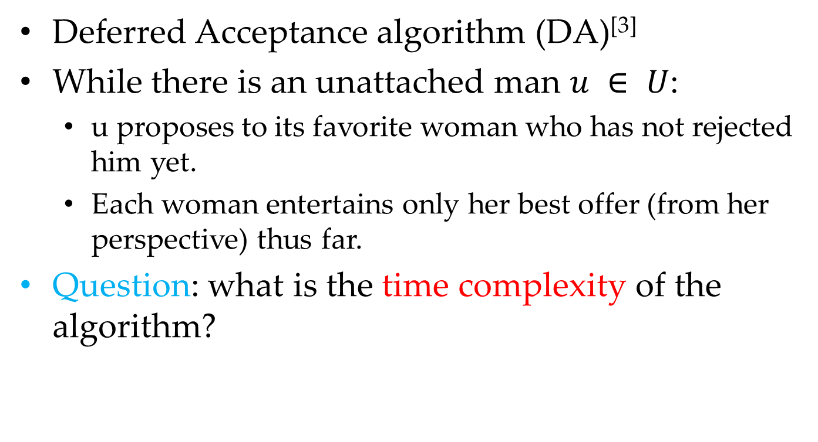
Stable Matching: Algorithm
Deferred Acceptance algorithm (DA)^{[3]}
While there is an unattached man $u ∈ U$:
u proposes to its favorite woman who has not rejected him yet.
Each woman entertains only her best offer (from her perspective) thus far.
Question: what is the time complexity of the algorithm?
[3] D. Gale and L. S. Shapley. College admissions and the stability of marriage. American Mathematical Monthly, 69:9-15, 1962.

Slide 64
Exercise

Slide 65
Exercise 42
Recall the matching-based kidney exchange mechanism from lecture. Prove that this mechanism is DSIC.
no agent (i.e., patient-donor pair) can be made better off (i.e., go from unmatched to matched) by reporting a strict subset F_{i} of its true edge set E_{i}

Slide 66
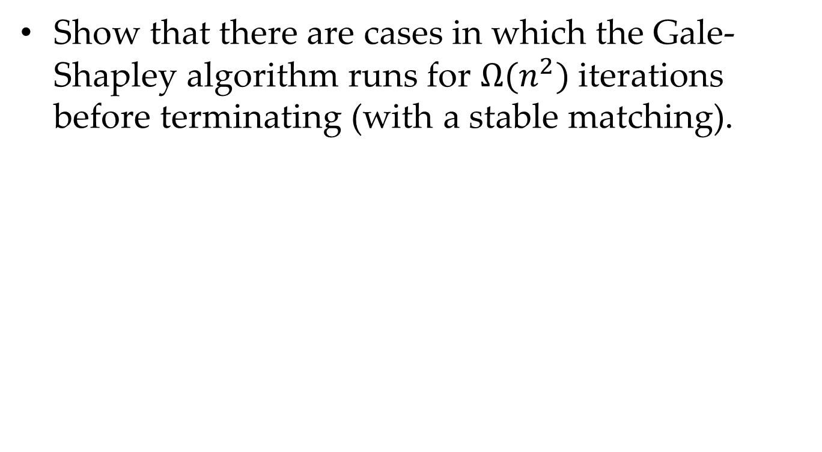
Exercise 43
Show that there are cases in which the Gale-Shapley algorithm runs for $Ω(n^{2})$iterations before terminating (with a stable matching).

Slide 67
Exercise 44
Prove that the Gale-Shapley proposal algorithm is not DSIC for the right-hand side (the women).
i.e., there are cases in which a woman can submit a false total ordering over the men and receive a better mate than when reporting its true preferences.

Slide 68
Programming Exercise
TBD

Slide 69
Summary

Slide 70
Summary
Case Study 1: Kidney Exchange
Case Study 2: Stable Matching

Slide 71
Thanks
Any Questions ???

Slide 72
XXXX

Slide 73
XXXX

